Slide 1
Recent Advances in Pre-trained Language Models: Why Do They Work and How to Use Them
2022 AACL-IJCNLP
姜成翰 Cheng-Han Chiang
National Taiwan University
莊永松 Yung-Sung Chuang
CSAIL,MIT
李宏毅 Hung-yi Lee
National Taiwan University

Slide 2
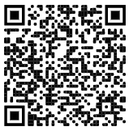
Recent Advances in Pre-trained Language Models: Why Do They Work and How to Use Them
2022 AACL-IJCNLP
17:00 – 17:10 Part 1 Introduction
17:10 – 17:40 Part 2 Why do PLMs work
Hung-yi Lee
National Taiwan University
Link to slides

Slide 3
Recent Advances in Pre-trained Language Models: Why Do They Work and How To Use Them
2022 AACL-IJCNLP
17:40 – 18:20 Part 3 How to Use PLMs: Contrastive learning 17:40 – 18:20 Part 3 for Pre-trained Language Models
Yung-Sung Chuang
CSAIL,MIT
Link to slides

Slide 4
Recent Advances in Pre-trained Language Models: Why Do They Work and How to Use Them
2022 AACL-IJCNLP
18:40 – 19:50 Part 4 + 5 How to Use PLMs: New fine-tuning 19:00 – 20:15 Part 4 + 5 methods
Cheng-Han Chiang
National Taiwan University
Link to slides

Slide 5
Schedule
17:00 – 17:10 Part 1 Introduction [Hung-yi]
17:10 – 17:40 Part 2 Why do PLMs work [Hung-yi]
17:40 – 18:20 Part 3 How to use PLMs: Contrastive Learning for PLMs [Yung-Sung]
18:20 – 18:30 Q&A for Part 1+2+3
18:30 – 18:40 Break
18:40 – 19:05 Part 4 How to use PLMs: Parameter-efficient fine-tuning [Cheng-
19:00 – 19:30 Part 4 Han]
19:05 – 19:50 Part 5 How to use PLMs: Using PLMs with different amounts of data
19:30 – 20:15 Part 5 [Cheng-Han]
19:50 – 20:00 Conclusion and Future work + Q&A

Slide 6
2022 AACL-IJCNLP
Part 1:
Introduction
Hung-yi Lee
National Taiwan University

Slide 7
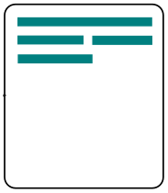
Deep Learning for Human Language Processing
Summarization
document
summary
Machine Translation
source
language
target
language

Slide 8
So many different tasks ……
https://youtu.be/tFBrqPPxWzE
Speech Recognition
Coreference Resolution
Speaker Recognition
Syntactic Parsing
Text-to-Speech (TTS)
Semantic Parsing
Denoising
Chatbot
Speech Separation
Summarization
Voice Conversion (VC)
Text Style Transfer
Spoken Term Detection (STD)
Retrieval
Speech Question Answering
Question Answering
Speech Translation
Text Translation
Spoken Language Understanding
Dialogue State Tracking
……
……

Slide 9
So many languages ……
There are around 7,000 languages in the world.

Slide 10
Framework of Pre-training
Pre-train
Fine-tune
Labeled data for task 1
Develop general purpose knowledge
Model
for task 1
Unlabeled data
(Task-agnostic)
Model
for task 2
Pre-trained Model
Self-supervised Model
Foundation Model
Labeled data for task 2

Slide 11
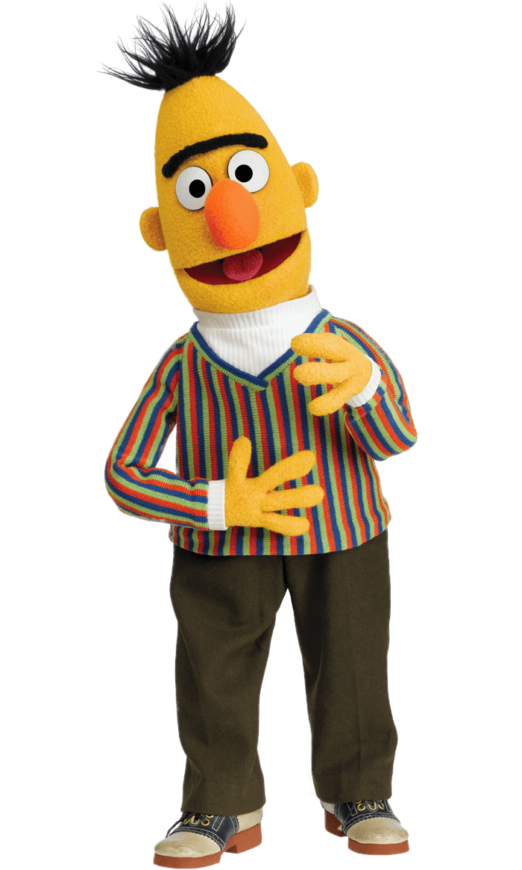
Pre-training for NLP
you
Pre-train
Masked Language Model (MLM)
Linear
Reconstruction
BERT
Unlabeled text data
BERT
how
are
you
today

Slide 12
This is not a complete survey!
https://arxiv.org/abs/2107.13586
https://arxiv.org/abs/2002.12327
https://arxiv.org/abs/2003.08271

Slide 13
Pre-training for NLP
Pre-train
Fine-tune
Sentiment analysis
pos
neg
Question Answering
Unlabeled text data
BERT
context
query
ans

Slide 14
Pre-training for NLP - Fine-tune (Example)
class
Input: sequence
output: class
Linear
Random initialization
Example:
Sentiment analysis
Better than random
this is good
Init by pre-train
BERT
positive
This is the model to be learned.
[CLS]
w₁
w₂
w₃
sentence
Notes:
Do I have to mention adaptor???
(https://arxiv.org/abs/1805.12471)

Slide 15
Pre-training for NLP
General Language Understanding Evaluation (GLUE)
Corpus of Linguistic Acceptability (CoLA)
Stanford Sentiment Treebank (SST-2)
Microsoft Research Paraphrase Corpus (MRPC)
Quora Question Pairs (QQP)
Semantic Textual Similarity Benchmark (STS-B)
Multi-Genre Natural Language Inference (MNLI)
Question-answering NLI (QNLI)
Recognizing Textual Entailment (RTE)
Winograd NLI (WNLI)
https://gluebenchmark.com/
Notes:
COLA: Each example is a sequence of words annotated with whether it is a grammatical English sentence
MRPC: with human annotations for whether the sentences in the pair are semantically equivalent
QQP:o determine whether a pair of questions are semantically equivalent.
STS: Each pair is human-annotated with a similarity score from 1 to 5; the task is to predict these scores

Slide 16
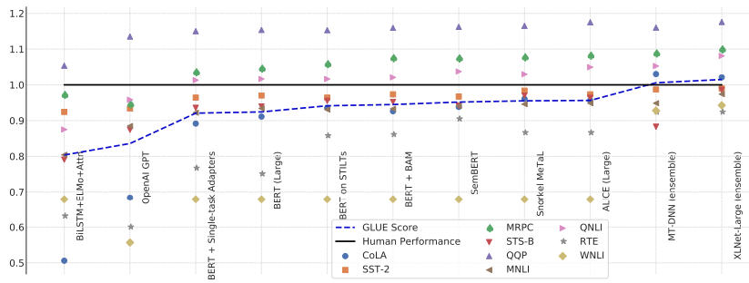
Pre-training for NLP
Source of image: https://arxiv.org/abs/1905.00537
GLUE scores

Slide 17
Pre-training for Speech
Pre-train
PASE+
APC
NPC
Tera
DeCoAR
Wav2vec
HuBERT
WavLM
Just name a few …
Unlabeled
speech data
“speech version” of BERT

Slide 18
Pre-training for Speech
Pre-train
Fine-tune
Speech
Recognition
“how are you”
Speaker
Recognition
Unlabeled
speech data
“speech version” of BERT
Speaker 42

Slide 19
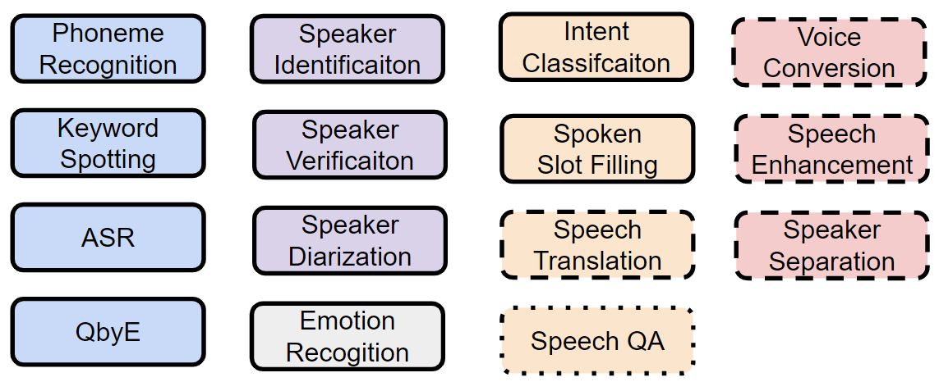
Speech processing Universal PERformance Benchmark (SUPERB)
https://superbbenchmark.org/
Published
at IS 2021
Published
at ACL 2022
Published
at IS 2022
Content
Speaker
Paralinguistic
Semantic
Synthesis

Slide 20
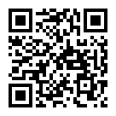
Presented at INTERSPEECH 2021
https://arxiv.org/abs/2105.01051
https://youtu.be/GTjwYzFG54E
Presented at ACL 2022
https://arxiv.org/abs/2203.06849

Slide 21
https://arxiv.org/abs/2205.10643

Slide 22
Schedule
17:00 – 17:10 Part 1 Introduction [Hung-yi]
17:10 – 17:40 Part 2 Why do PLMs work [Hung-yi]
17:40 – 18:20 Part 3 How to use PLMs: Contrastive Learning for PLMs [Yung-Sung]
18:20 – 18:30 Q&A for Part 1+2+3
18:30 – 18:40 Break
18:40 – 19:05 Part 4 How to use PLMs: Parameter-efficient fine-tuning [Cheng-
19:00 – 19:30 Part 4 Han]
19:05 – 19:50 Part 5 How to use PLMs: Using PLMs with different amounts of data
19:30 – 20:15 Part 5 [Cheng-Han]
19:50 – 20:00 Conclusion and Future work + Q&A

Slide 23
2022 AACL-IJCNLP
Part 2:
Why do PLMs work
Hung-yi Lee
National Taiwan University

Slide 24
Contextualized Word Representations
you
The tokens with similar meaning have similar embedding.
Embedding
Linear
orange
Eat an
apple
bird
BERT
fish
machine
apple computer
how
are
you
today
Context is considered.
Notes:
Should I find a real example here?
We find that existing models trained on language modeling and translation produce strong representations for syntactic phenomena

Slide 25
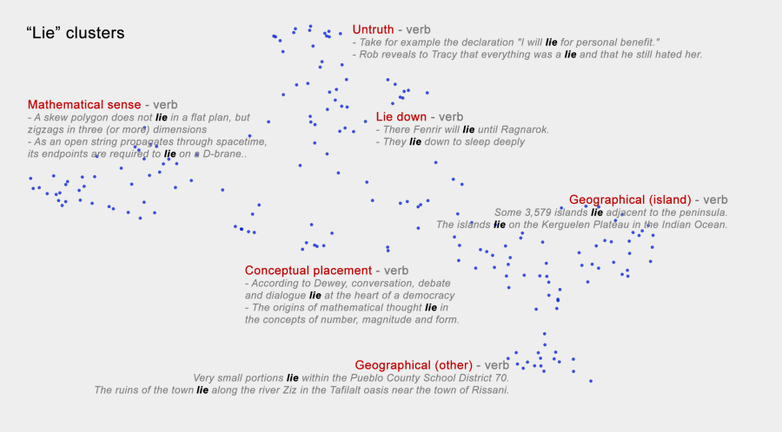
Andy Coenen, Emily Reif, Ann Yuan, Been Kim, Adam Pearce, Fernanda Viégas, Martin Wattenberg, Visualizing and Measuring the Geometry of BERT, NeurIPS, 2019
Notes:
Visualizing and measuring the geometry of BERT
We conjecture that the internal geometry of BERT may be broken into multiple linear subspaces, with separate spaces for different syntactic and semantic information.
BERT_viz_appendix.pdf
https://proceedings.neurips.cc/paper/2019/hash/159c1ffe5b61b41b3c4d8f4c2150f6c4-Abstract.html

Slide 26
BERTology - What does each layer learn?
Transformer Block
Probing
…
…
…
…
Transformer Block
Noun?
Verb?
POS
Classifier
BERT
NER
Classifier
Place?
Name?
Transformer Block
how
are
you
today
Notes:
Observation 1: PLMs learn linguistic knowledge during pre-training
Evidence: Probing experiments

Slide 27
BERTology - What does each layer learn?
Higher classifier accuracy does not always mean encoding more information.
Interpret the prob results with care ☺
John Hewitt, Percy Liang, Designing and Interpreting Probes with Control Tasks, EMNLP, 2019
Elena Voita, Ivan Titov, Information-Theoretic Probing with Minimum Description Length, EMNLP, 2020
John Hewitt, Kawin Ethayarajh, Percy Liang, Christopher Manning, Conditional probing: measuring usable information beyond a baseline, ENMLP, 2021
Jiaoda Li, Ryan Cotterell, Mrinmaya Sachan, Probing via Prompting, NAACL, 2022
Notes:
Be careful about the classifiers you use …
Higher classifier accuracy does not always mean encoding more information.
Probing via Prompting: https://aclanthology.org/2022.naacl-main.84/

Slide 28
BERTology - What does each layer learn?
Transformer Block
Semantic
Transformer Block
Syntactic
…
…
…
…
BERT
Transformer Block
Surface
Transformer Block
how
are
you
today
Sentence

Slide 29
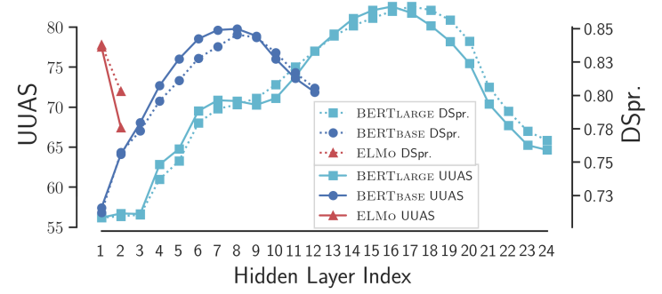
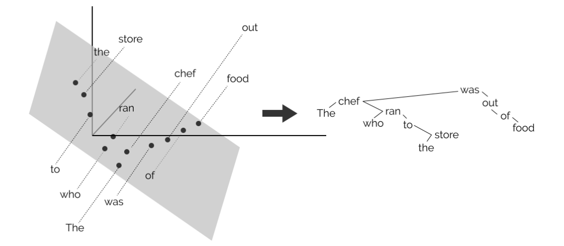
Encoding Syntax
John Hewitt, Christopher D. Manning, A Structural Probe for Finding Syntax in Word Representations, NAACL, 2019
Notes:
We find that existing models trained on language modeling and translation produce strong representations for syntactic phenomena
https://docs.google.com/presentation/d/1IlNqFNknS1BvsDsuuUrYzPLfarakmMoZSJz-egvGbnw/edit#slide=id.p
https://github.com/john-hewitt/structural-probes
https://nlp.stanford.edu//~johnhew//public/hewitt2019structural_slides.pdf

Slide 30
BERTology - What does each layer learn?
Ganesh Jawahar, Benoît Sagot, Djamé Seddah, What Does BERT Learn about the Structure of Language?, ACL, 2019

Slide 31
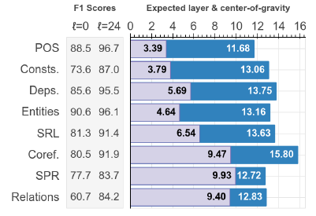
BERTology - What does each layer learn?
Ian Tenney, Dipanjan Das, Ellie Pavlick, BERT Rediscovers the Classical NLP Pipeline, ACL, 2019

Slide 32
Transformer Block
Semantic
Semantic
Transformer Block
Syntactic
Input dependent
Syntactic
…
…
…
…
BERT
Transformer Block
Surface
Transformer Block
Surface
how
are
you
today
Sentence
Sentence
Jingcheng Niu, Wenjie Lu, Gerald Penn, Does BERT Rediscover a Classical NLP Pipeline?, COLING, 2022
Wietse de Vries, Andreas van Cranenburgh, Malvina Nissim, What’s so special about BERT’s layers? A closer look at the NLP pipeline in monolingual and multilingual models, EMNLP Finding, 2020
Notes:
Jingcheng Niu, Wenjie Lu, Gerald Penn, Does BERT Rediscover a Classical NLP Pipeline?, COLING, 2022
Wietse de Vries, Andreas van Cranenburgh, Malvina Nissim, What’s so special about BERT’s layers? A closer look at the NLP pipeline in monolingual and multilingual models, EMNLP Finding, 2020
https://aclanthology.org/2020.findings-emnlp.389.pdf
we show that also within a given task, information is spread over different parts of the network and the pipeline might not be as neat as it seems. Each layer has different specialisations, so that it may be more useful to combine information from different layers, instead of selecting a single one based on the best overall performance.
Did BERT rediscover an NLP pipeline? Not in a naïve, architectural sense

Slide 33
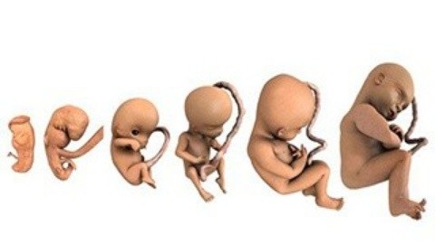
BERT Embryology
Cheng-Han Chiang, Sung-Feng Huang, Hung-yi Lee, Pretrained Language Model Embryology: The Birth of ALBERT, EMNLP, 2020
Leo Z. Liu, Yizhong Wang, Jungo Kasai, Hannaneh Hajishirzi, Noah A. Smith, Probing Across Time: What Does RoBERTa Know and When? EMNLP-finding, 2021
Analyzing what BERT learned during training
When does BERT know POS tagging, syntactic parsing, semantics?
Notes:
some spoil here
https://arxiv.org/abs/2010.02480
Analyzing what BERT learned during training

Slide 34
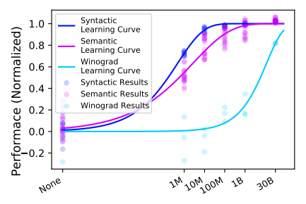
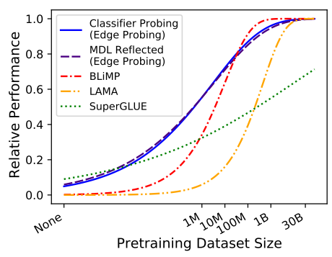
When Do You Need Billions of Words of Pretraining Data?
Yian Zhang, Alex Warstadt, Xiaocheng Li, Samuel R. Bowman, When Do You Need Billions of Words of Pretraining Data? ACL 2021

Slide 35
Pre-trained Intrinsic Dimension
Smaller intrinsic dimension means better generalization
Armen Aghajanyan, Sonal Gupta, Luke Zettlemoyer, Intrinsic Dimensionality Explains the Effectiveness of Language Model Fine-Tuning, ACL, 2021
Notes:
Aghajanyan, Armen, Sonal Gupta, and Luke Zettlemoyer. "Intrinsic Dimensionality Explains the Effectiveness of Language Model Fine-Tuning." Proceedings of the 59th Annual Meeting of the Association for Computational Linguistics and the 11th International Joint Conference on Natural Language Processing (Volume 1: Long Papers). 2021
Observation 4: Pre-training reduces the intrinsic dimension of downstream tasks
Evidence:
https://arxiv.org/abs/2012.13255
Given our task representation interpretation of intrinsic dimensionality, we argue that the large scale training of Masked Language Models (MLM) learns generic and distributed enough representations of language to facilitate downstream learning of highly compressed task representations.

Slide 36
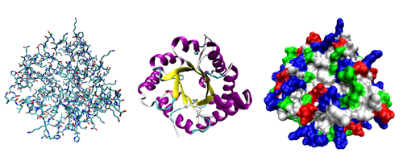
Cross-discipline Capability
Pre-train
Fine-tune
Testing
DNA
Classification
Protein
Classification
Human Language
Wei-Tsung Kao, Hung-yi Lee, Is BERT a Cross-Disciplinary Knowledge Learner? A Surprising Finding of Pre-trained Models’ Transferability, EMNLP finding, 2021
Notes:
Observation 3: PLMs learn to capture word dependencies in the sequences during pre-training
Evidence: Transferring from artificial language
https://arxiv.org/abs/2109.03537

Slide 37
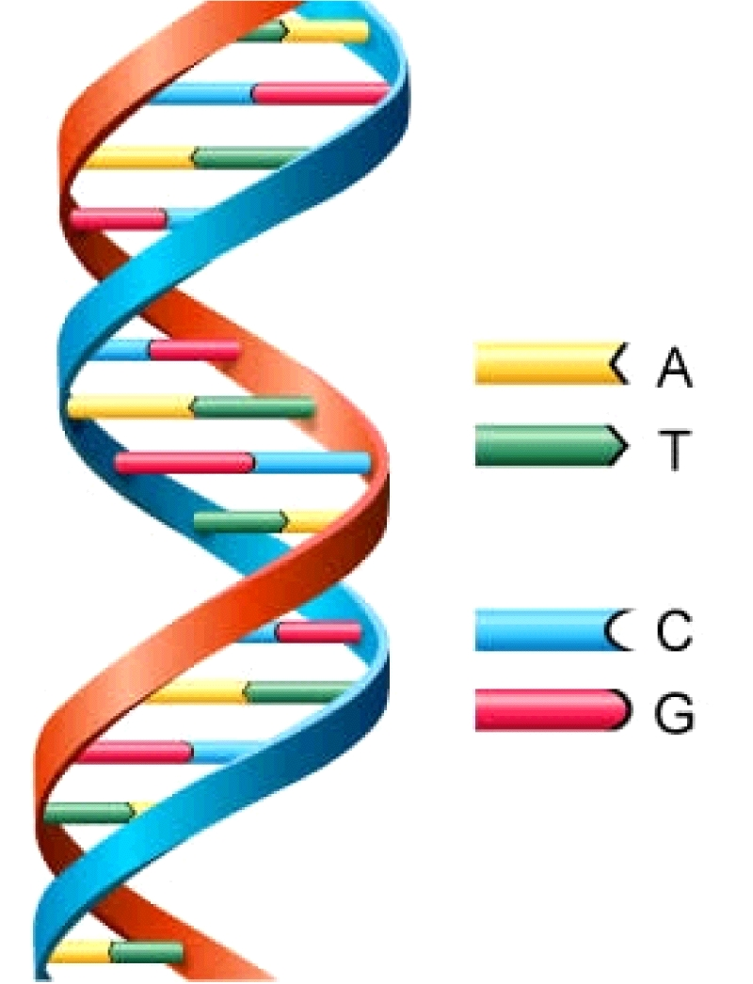
Cross-discipline Capability
Downstream task
EI CCAGCTGCATCACAGGAGGCCAGCGAGCAGGTCTGTTCCAAGGGCCTTCGAGCCAGTCTG
EI AGACCCGCCGGGAGGCGGAGGACCTGCAGGGTGAGCCCCACCGCCCCTCCGTGCCCCCGC
IE AACGTGGCCTCCTTGTGCCCTTCCCCACAGTGCCCTCTTCCAGGACAAACTTGGAGAAGT
IE CCACTCAGCCAGGCCCTTCTTCTCCTCCAGGTCCCCCACGGCCCTTCAGGATGAAAGCTG
IE CCTGATCTGGGTCTCCCCTCCCACCCTCAGGGAGCCAGGCTCGGCATTTCTGGCAGCAAG
IE AGCCCTCAACCCTTCTGTCTCACCCTCCAGCCTAAAGCTCCTTGACAACTGGGACAGCGT
IE CCACTCAGCCAGGCCCTTCTTCTCCTCCAGGTCCCCCACGGCCCTTCAGGATGAAAGCTG
N CTGTGTTCACCACATCAAGCGCCGGGACATCGTGCTCAAGTGGGAGCTGGGGGAGGGCGC
N GTGTTACCGAGGGCATTTCTAACAGTCTTCTTACTACGGCCTCCGCCGACCGCGCGCTCG
N TCTGAGCTCTGCATTTGTCTATTCTCCAGCTGACCCTGGTTCTCTCTCTTAGCTACCTGC
class
DNA sequence

Slide 38
Cross-discipline Capability
class
Linear
Random initialization
pre-train on English
Init by pre-train
A | we
T | you
C | he
G | she
BERT
[CLS]
we
she
we
he
DNA sequence
A
G
A
C

Slide 39
Cross-discipline Capability
Applying BERT to protein, DNA, music classification
The pretrained models learn some general skills for the classification.
Notes:
https://ppfocus.com/hk/0/di75f00e4.html

Slide 40
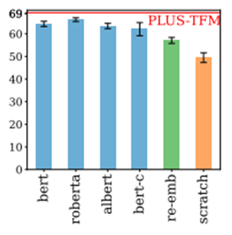
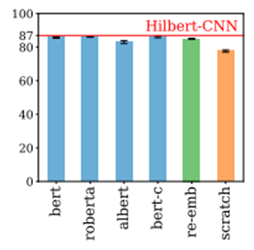
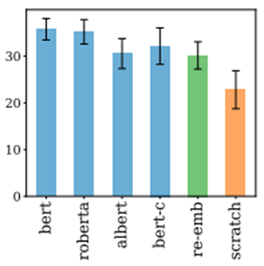
Cross-discipline Capability
DNA Classification
Protein Classification
Music Classification
(average 3 tasks)
(average 4 tasks)

Slide 41
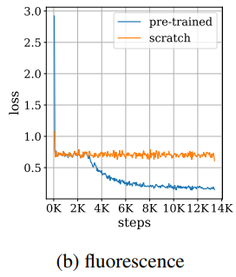
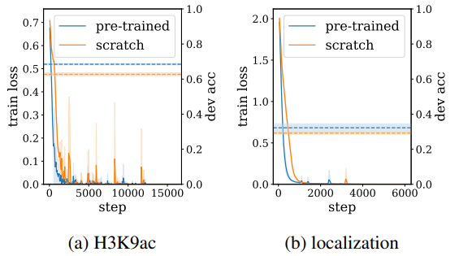
How pre-trained model improve the performance?
Optimization
Generalization
The pretrained models help both optimization and generalization.

Slide 42
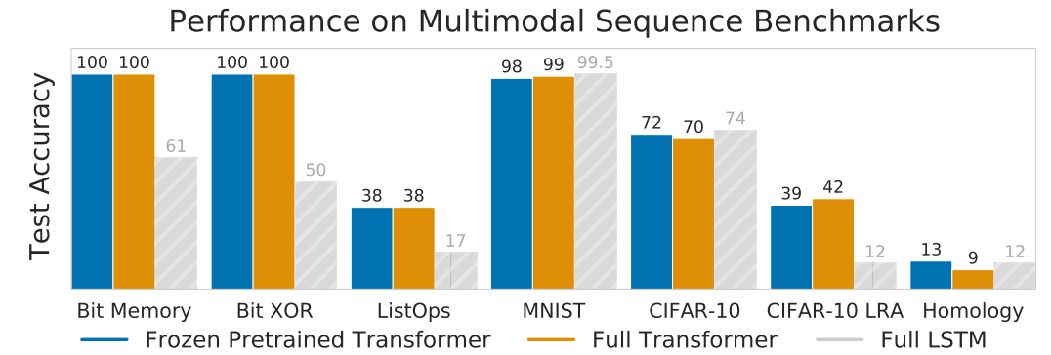
To learn more …
Kevin Lu, Aditya Grover, Pieter Abbeel, Igor Mordatch, Pretrained Transformers as Universal Computation Engines, arXiv, 2021
Notes:
Pretrained Transformers as Universal Computation Engines
The works is from UC Berkeley

Slide 43
Pre-training on Artificial Data
Cheng-Han Chiang, Hung-yi Lee, On the Transferability of Pre-trained Language Models: A Study from Artificial Datasets, AAAI, 2022
We have seen the cross-discipline capability of self-supervised model ……
Pre-train
Fine-tune
Testing
We can pre-train model on data other than text.
A set of NLP Tasks

Slide 44
Pre-training on Artificial Data
Cheng-Han Chiang, Hung-yi Lee, On the Transferability of Pre-trained Language Models: A Study from Artificial Datasets, AAAI, 2022
We have seen the cross-discipline capability of self-supervised model ……
Pre-train
Fine-tune
Testing
……
1
2
1
1
7
7
3
9
3
6
5
4
……
7
3
5
1
5
9
……
Token generation by rules
A set of NLP Tasks
By generating artificial data with different rules, we can know what are the key factors for the success of pre-training.

Slide 45
Pre-train
……
NLP Downstream Task:
Sentiment Analysis
1
2
1
1
7
7
……
pos/neg
3
9
3
6
5
4
7
3
5
1
5
9
……
Linear
Fine-tune
Token generation by rules
ID | text
1 | the
2 | a
3 | Is
4 | good
… | …
101 | movie
… | …
BERT pre-training on token IDs
(take token IDs as input)
[CLS]
1
101
3
4
the
movie
is
good

Slide 46
Pre-training on Artificial Data
Absolute improvement (%) compared to training from scratch
Average performance on GLUE tasks
Upper bound

Slide 47
Pre-training on Artificial Data
Absolute improvement (%) compared to training from scratch
Pre-training on random tokens yields the same performance as training from scratch.
Data plays the role.

Slide 48
Pre-training on Artificial Data
Also refer to:
Isabel Papadimitriou, Dan Jurafsky, Learning Music Helps You Read: Using Transfer to Study Linguistic Structure in Language Models, EMNLP, 2020
Absolute improvement (%) compared to training from scratch
All the tokens in the generated sequences are paired.
7
3
5
1
5
1
7
3
Structured data is critical for learning useful skills for NLP.
Is it true?

Slide 49
Pre-training on Artificial Data
Absolute improvement (%) compared to training from scratch
Shuffle
…
1
2
3
63
64
…
57
9
5
22
43
To predict this token, model needs to go through the whole sequence.
Is long-range reading the key to the success of a pretrained model?

Slide 50
Absolute improvement (%) compared to training from scratch
……
1
2
3
4
3
4
5
6
4
2
3
1
4
5
6
3
……
Longer consecutive tokens, better performance in NLP tasks
Learning to read a long-range in a sequence is crucial.
Are there more factors?
Need more investigation ☺
Length of consecutive tokens

Slide 51
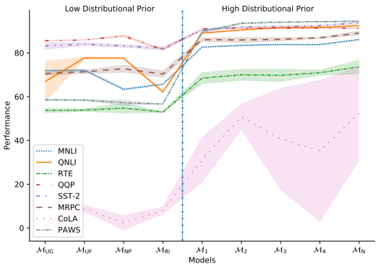
To learn more ……
AACL-IJCNLP 2022 will be held online from November 20-23 , 2022 .
will 2022 , be November . online 2022 from held 20-23 AACL-IJCNLP
Koustuv Sinha, Robin Jia, Dieuwke Hupkes, Joelle Pineau, Adina Williams, Douwe Kiela, Masked Language Modeling and the Distributional Hypothesis: Order Word Matters Pre-training for Little, EMNLP, 2021
Notes:
https://arxiv.org/pdf/2104.06644.pdf
Koustuv Sinha, Robin Jia, Dieuwke Hupkes, Joelle Pineau, Adina Williams, Douwe Kiela, Masked Language Modeling and the Distributional Hypothesis: Order Word Matters Pre-training for Little, EMNLP, 2021

Slide 52
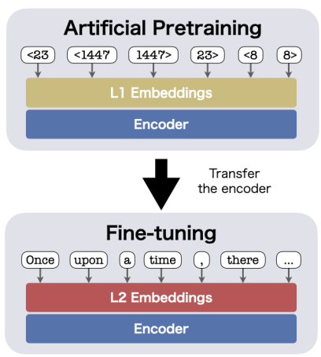
To learn more ……
What knowledge in pretrained encoders are transferred across different languages?
“tokens in a sequence can be characterized by its neighbor tokens at specific positions”
Ryokan Ri, Yoshimasa Tsuruoka, Pretraining with Artificial Language: Studying Transferable Knowledge in Language Models, ACL, 2022

Slide 53
Concluding Remarks of Part 2
Why do PLMs work?
Contextualized word representations
BERTology: Analyzing what is learned by BERT
BERT Embryology: Analyzing what BERT learned during training
Cross-discipline Capability
Pre-training on Artificial Data
Don't know the answer yet.

Slide 54
Schedule
17:00 – 17:10 Part 1 Introduction [Hung-yi]
17:10 – 17:40 Part 2 Why do PLMs work [Hung-yi]
17:40 – 18:20 Part 3 How to use PLMs: Contrastive Learning for PLMs [Yung-Sung]
18:20 – 18:30 Q&A for Part 1+2+3
18:30 – 18:40 Break
18:40 – 19:05 Part 4 How to use PLMs: Parameter-efficient fine-tuning [Cheng-
19:00 – 19:30 Part 4 Han]
19:05 – 19:50 Part 5 How to use PLMs: Using PLMs with different amounts of data
19:30 – 20:15 Part 5 [Cheng-Han]
19:50 – 20:00 Conclusion and Future work + Q&A

Slide 55
2022 AACL-IJCNLP
Part 3:
How to use PLMs:
Contrastive Learning for PLMs
Yung-Sung Chuang
CSAIL, MIT

Slide 56
Computer Vision:
CPC, SimCLR, MoCo, SwAV
Contrastive Learning
Speech Processing:
CPC, wav2vec,wav2vec2.0
NLP (?)

Slide 57
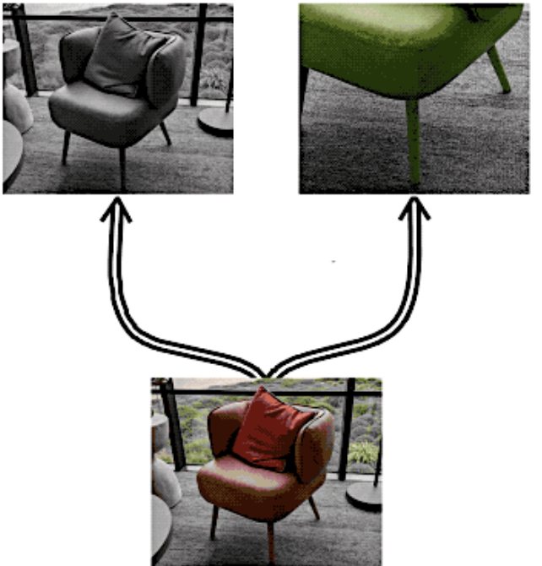
Why Contrastive?
We want to obtain a good representation space such that
1. Similar inputs have similar representations. -> Positive Pairs
Random crops from the same image
Images sampled from the same class

Slide 58
Why Contrastive?
We want to obtain a good representation space such that
2. Dissimilar inputs have dissimilar representations. -> Negative Pairs
Randomly sampled images

Slide 59
Contrastive Learning
SimCLR for Computer Vision

Slide 60
Contrastive Learning for NLP?
Masked Language Modeling shares some similarity to contrastive learning
Instance: contextualized representation of [MASK]
weather
Contexutalized
Positive Pairs:
non-contextualized representation of “weather”
BERT
Non-contexutalized
Negative Pairs:
non-contextualized representation of all the other words in the vocabulary
How is the [MASK] today ?

Slide 61
Why Contrastive on NLP?
MLM can be seen as a contrastive learning task using all negative pairs for training
Finite vocabulary size (30k for BERT) prevents negative sampling issues -> MLM can be trained as a simple token-level classification task
Are there any task has infinite possible inputs?
Sentence-level task!
We have infinite possible sentences; not possible to enumerate all the sentences in the world.
Good to apply contrastive learning for sentence-level representations.

Slide 62
Outline of Part 3
Why we need sentence-level representations?
Pre-BERT methods
How to obtain sentence-level representations from BERTs?
Post-processing Methods
Contrastive Learning Methods:
Designed Positives
Generating Positives
Bootstrapping Methods
Dropout Augmentations
Equivariant Contrastive Learning
Prompting
Ranking-based Methods
Conclusion

Slide 63
Outline of Part 3
Why we need sentence-level representations?
Pre-BERT methods
How to obtain sentence-level representations from BERTs?
Post-processing Methods
Contrastive Learning Methods:
Designed Positives
Generating Positives
Bootstrapping Methods
Dropout Augmentations
Equivariant Contrastive Learning
Prompting
Ranking-based Methods
Conclusion

Slide 64
General-Purpose Sentence Representations
Provide as a backbone that can be useful on a variety of downstream sentence-level tasks
Good generalization ability on tasks without much training data e.g. even linear probing can achieve good performance
Efficient sentence-level clustering or semantic search by inner products
Measure similarities among sentence pairs
Unsupervised methods are more desirable in order to be applied to languages beyond English
We will mainly focus on unsupervised methods through this tutorial!

Slide 65
Before BERT came out…
Skip-Thought Vectors, NIPS 2016 -> Next Sentence Prdiction

Slide 66
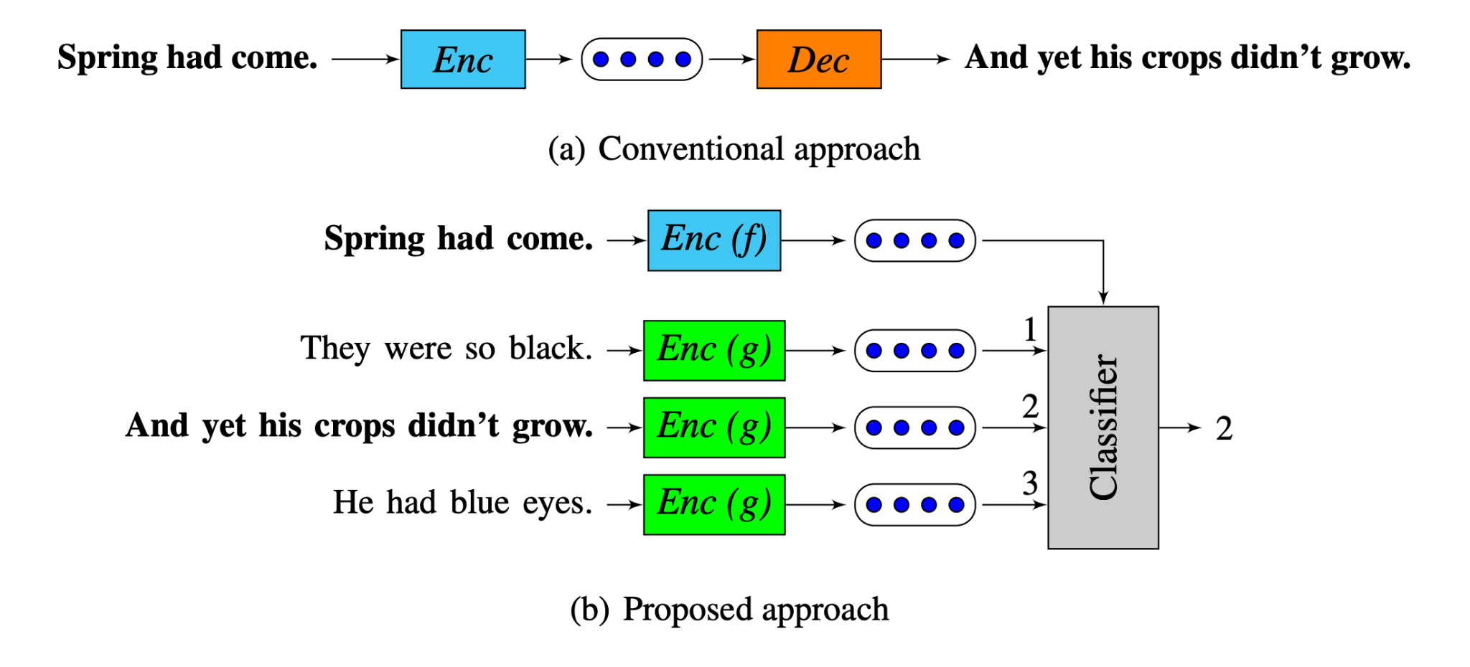
Before BERT came out…
Quick-Thought vectors, ICLR 2018 -> Next Sentence Prdiction w/o Decoder

Slide 67
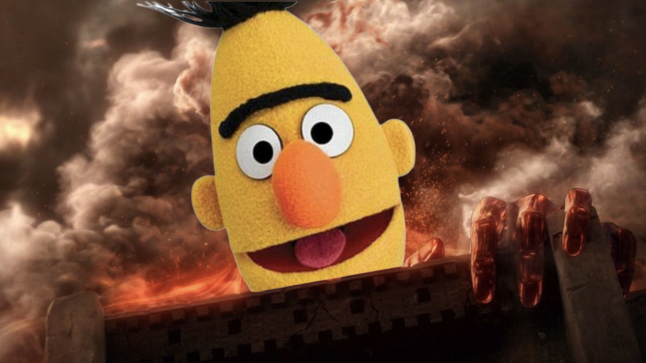
Oct 2018:
https://leemeng.tw/attack_on_bert_transfer_learning_in_nlp.html

Slide 68
How to obtain sentence representations from BERT?
It cannot be trivially obtained from token-level representations
Average pooling performs even worse than avg. GloVe embeddings

Slide 69
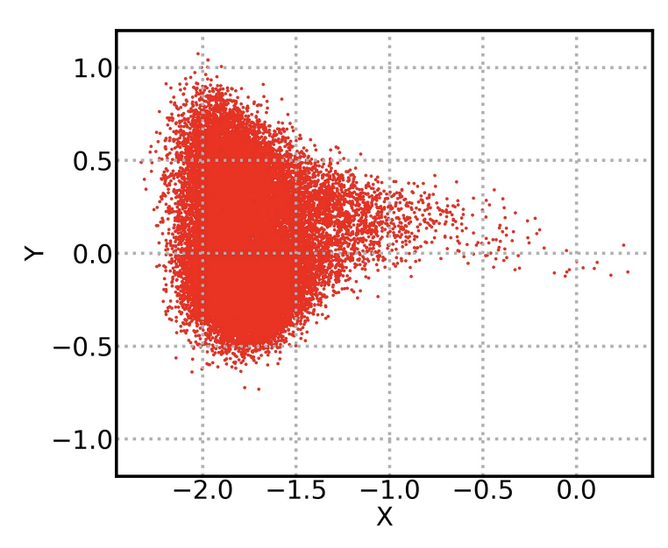
Anisotropy problem in BERT’s representation space
Representation degeneration: the learned embeddings occupy a narrow cone in the vector space
Limits the expressiveness of the vector space.

Slide 70
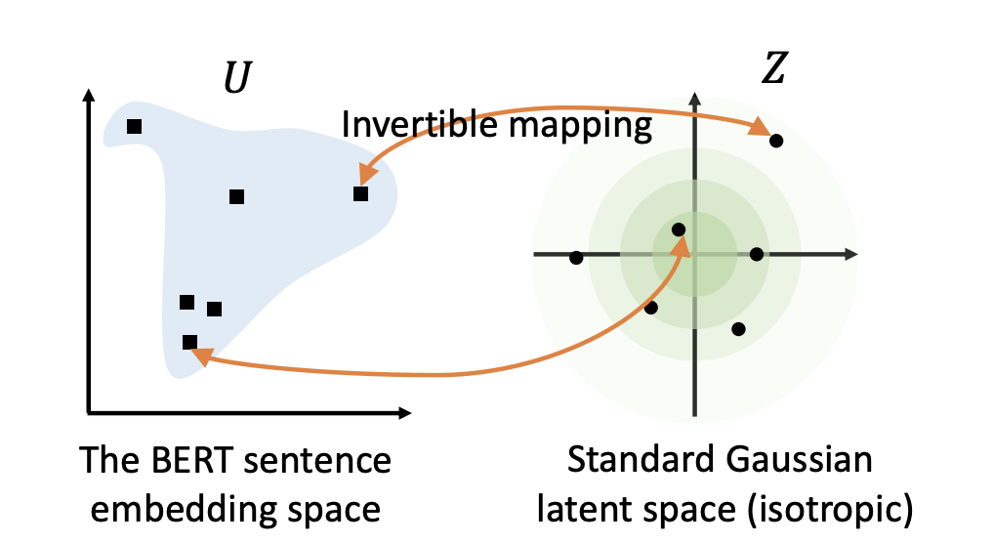
BERT-flow
non-smooth anisotropic semantic space
smooth isotropic semantic space

Slide 71
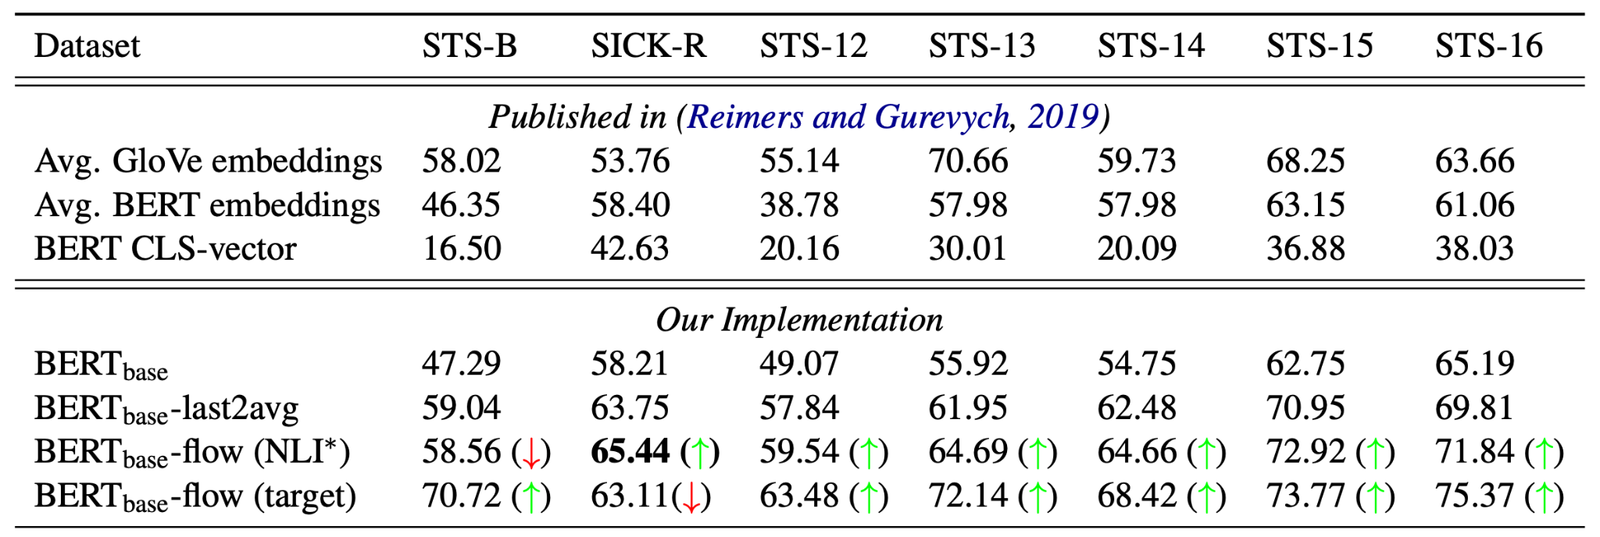
BERT-flow
Sentence Textual Similarity (STS) Task Data: Sentence pairs with 1-5 human ratings for the similarity Metric: Spearman Correlation between model predictions and human ratings

Slide 72
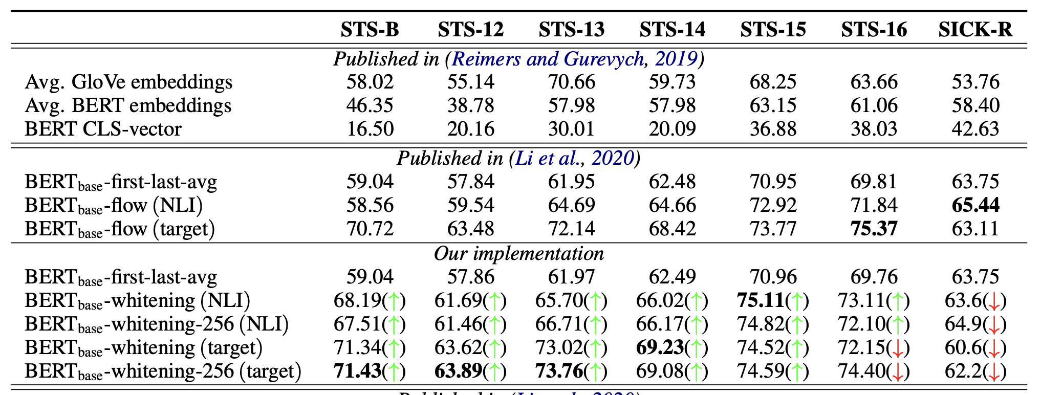
BERT-whitening
Using a simple whitening post-processing can outperform BERT-flow

Slide 73
We need further fine-tuning to extract better sentence embeddings from pre-trained language models…

Slide 74
Outline of Part 3
Why we need sentence-level representations?
Pre-BERT methods
How to obtain sentence-level representations from BERTs?
Post-processing Methods
Contrastive Learning Methods:
Designed Positives
Generating Positives
Bootstrapping Methods
Dropout Augmentations
Equivariant Contrastive Learning
Prompting
Ranking-based Methods
Conclusion

Slide 75
Contrastive Learning
How can we produce augmentations in NLP?
NLP?

Slide 76
Outline of Part 3
Why we need sentence-level representations?
Pre-BERT methods
How to obtain sentence-level representations from BERTs?
Post-processing Methods
Contrastive Learning Methods:
Designed Positives
Generating Positives
Bootstrapping Methods
Dropout Augmentations
Equivariant Contrastive Learning
Prompting
Ranking-based Methods
Conclusion

Slide 77
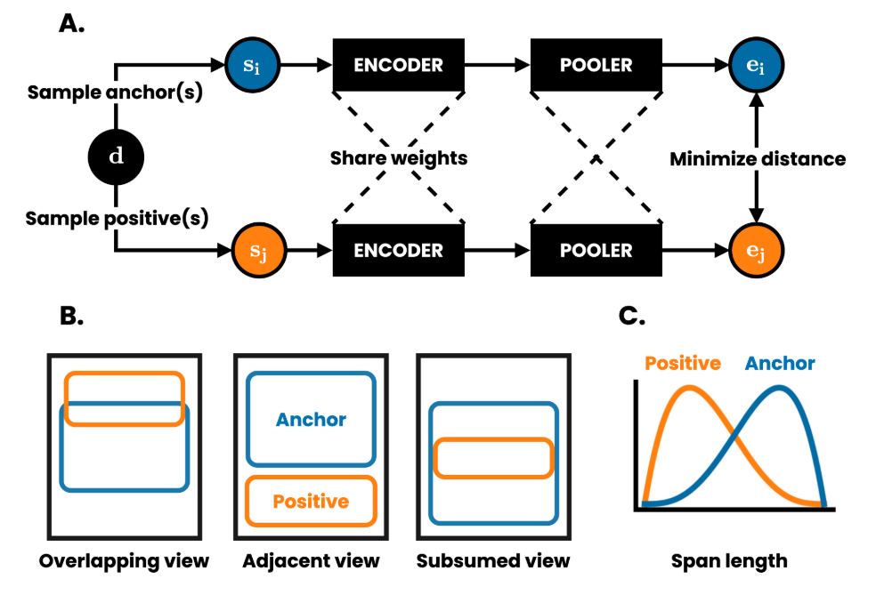
DeCLUTR
Positive Pairs:
Overlapping/adjacent spans from the same document
Negative Pairs:
hard negatives from the same docs
easy negatives from different docs

Slide 78
Results (STS)
Good improvement over post-processing methods
BERT-flow -- 63.11 70.72 -- 63.48 72.02 68.42 73.77 75.37
BERT-whitening -- 62.20 71.43 -- 63.89 73.76 69.08 74.59 74.40

Slide 79
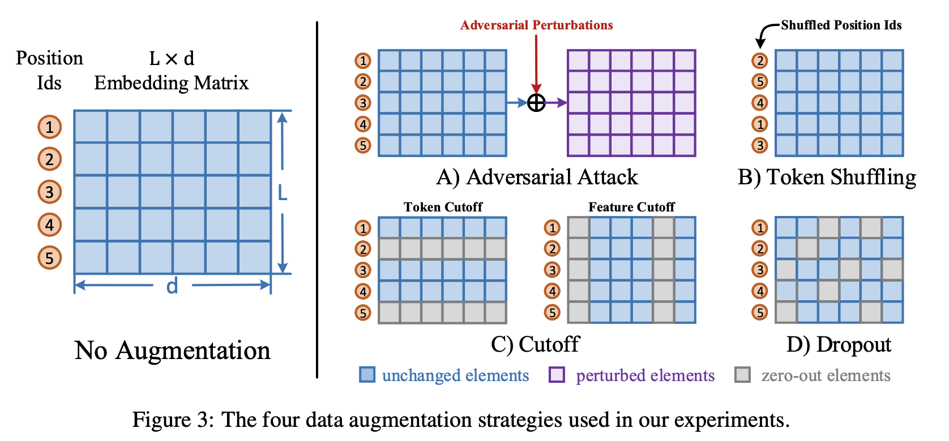
ConSERT
All the possible augmentations on token embedding space

Slide 80
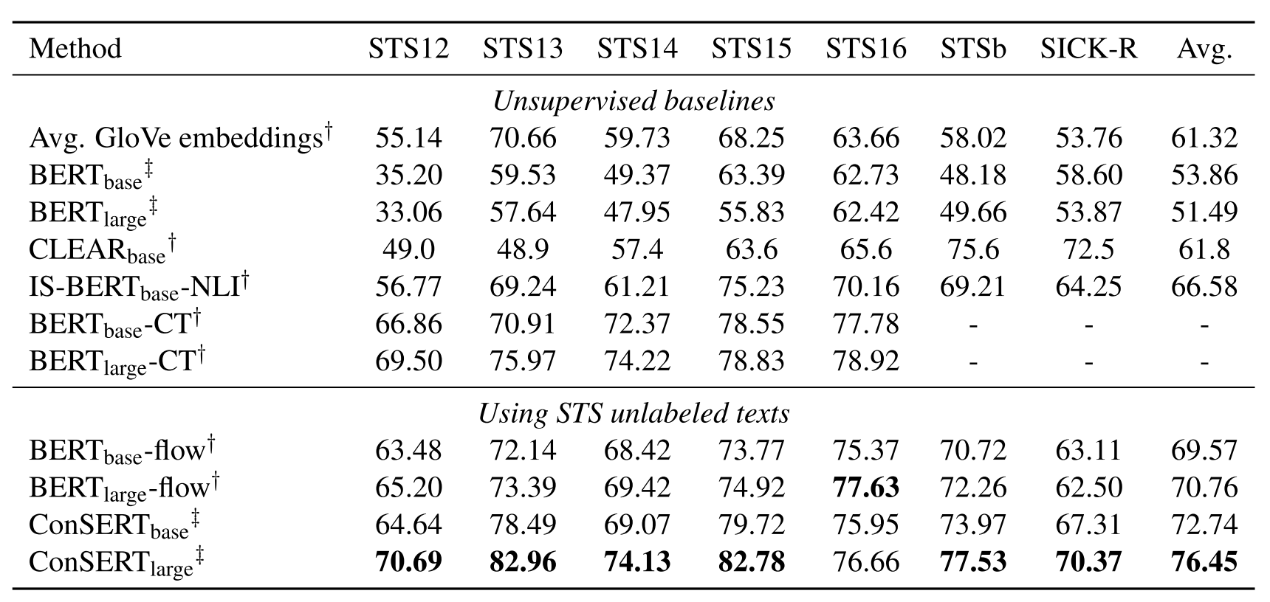
Experiments
Using unlabeled text to train contrastive loss for adaptation
DeCLUTR (BERT-base) 63.56 72.58 71.70 79.95 79.59 79.39 78.62 75.06

Slide 81
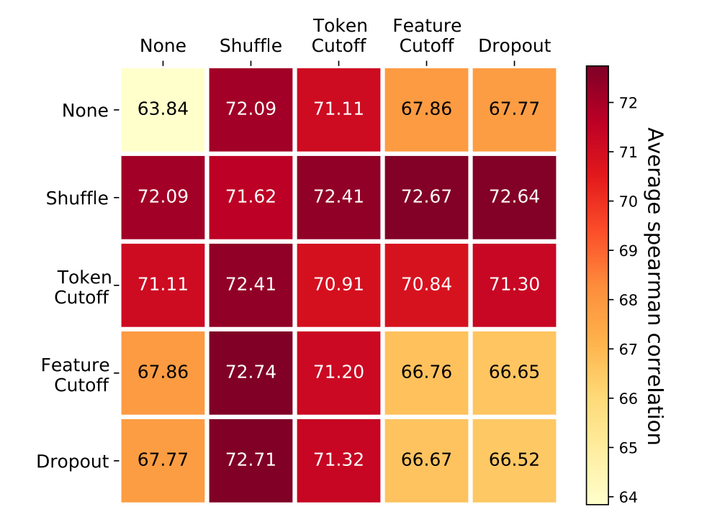
Effects of Augmentation Strategies

Slide 82
Outline of Part 3
Why we need sentence-level representations?
Pre-BERT methods
How to obtain sentence-level representations from BERTs?
Post-processing Methods
Contrastive Learning Methods:
Designed Positives
Generating Positives
Bootstrapping Methods
Dropout Augmentations
Equivariant Contrastive Learning
Prompting
Ranking-based Methods
Conclusion

Slide 83
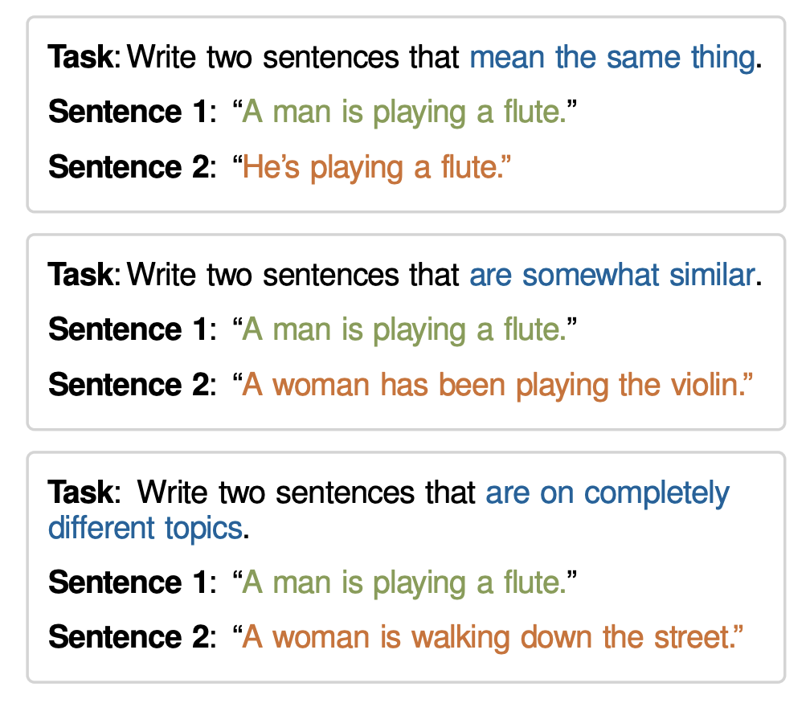
Datasets from Instructions (DINO 🦕)
Continuations generated by GPT-2 XL

Slide 84
Datasets from Instructions (DINO 🦕)
BERT-flow
DeCLUTR (BERT-base) 63.56 72.58 71.70 79.95 79.59 79.39 78.62 75.06
ConSERT (BERT-base) 64.64 78.49 69.07 79.72 75.95 73.97 67.31 72.74

Slide 85
Outline of Part 3
Why we need sentence-level representations?
Pre-BERT methods
How to obtain sentence-level representations from BERTs?
Post-processing Methods
Contrastive Learning Methods:
Designed Positives
Generating Positives
Bootstrapping Methods
Dropout Augmentations
Equivariant Contrastive Learning
Prompting
Ranking-based Methods
Conclusion

Slide 86
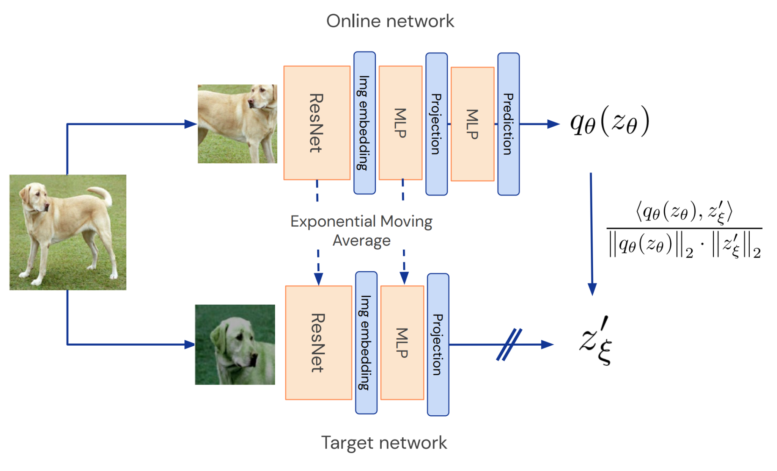
BYOL
Not contrastive learning
Only positive pairs, no negatives pairs
Use a moving average target network to prevent mode collapsing

Slide 87
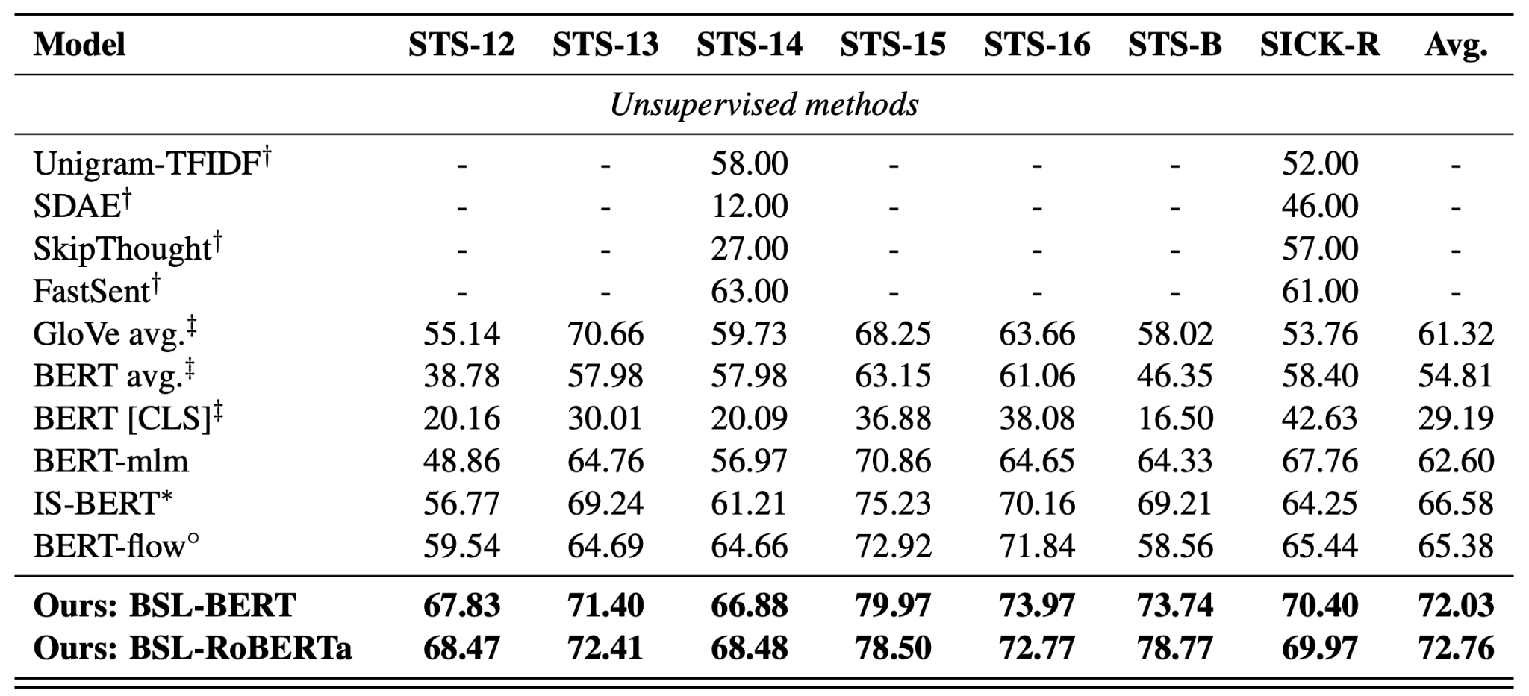
BYOL for sentence representations
Back-Translation as positive pairs
DeCLUTR (BERT-base) 63.56 72.58 71.70 79.95 79.59 79.39 78.62 75.06
ConSERT (BERT-base) 64.64 78.49 69.07 79.72 75.95 73.97 67.31 72.74
DINO (RoBERTa-base) 70.27 81.26 71.25 80.49 77.18 77.82 68.09 75.20

Slide 88
Outline of Part 3
Why we need sentence-level representations?
Pre-BERT methods
How to obtain sentence-level representations from BERTs?
Post-processing Methods
Contrastive Learning Methods:
Designed Positives
Generating Positives
Bootstrapping Methods
Dropout Augmentations
Equivariant Contrastive Learning
Prompting
Ranking-based Methods
Conclusion

Slide 89
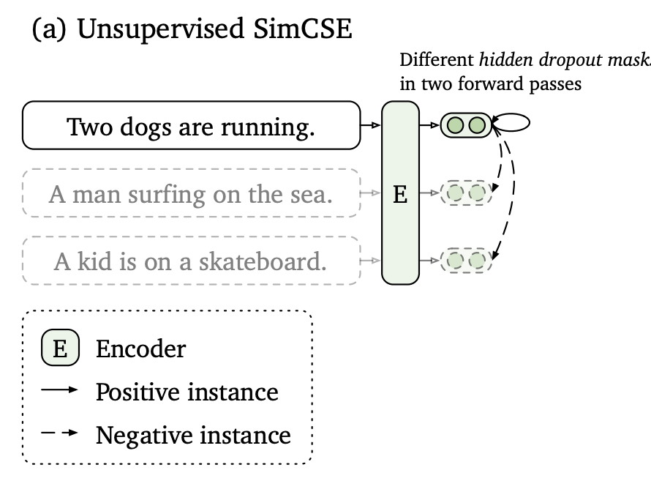
SimCSE (Unsupervised)
Using different dropout masks (in Transformer layers) as augmentation
-> Model architecture is the same

Slide 90
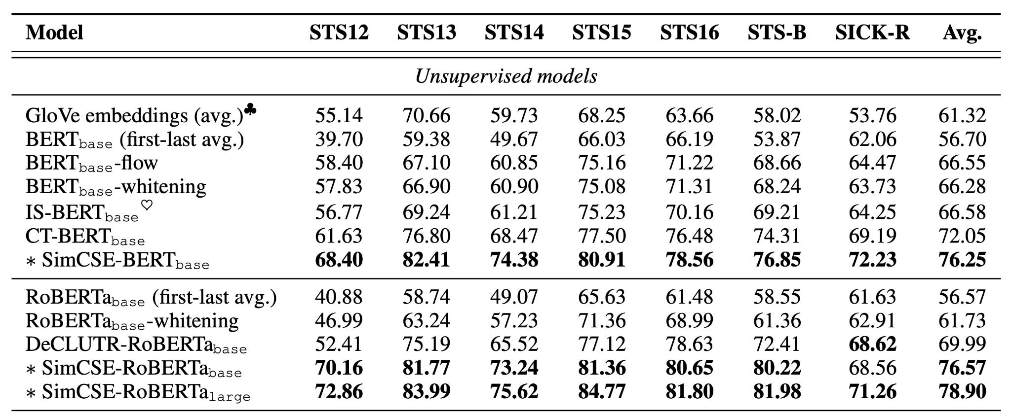
Results (STS)
DeCLUTR (BERT-base) 63.56 72.58 71.70 79.95 79.59 79.39 78.62 75.06
ConSERT (BERT-base) 64.64 78.49 69.07 79.72 75.95 73.97 67.31 72.74
DINO (RoBERTa-base) 70.27 81.26 71.25 80.49 77.18 77.82 68.09 75.20

Slide 91
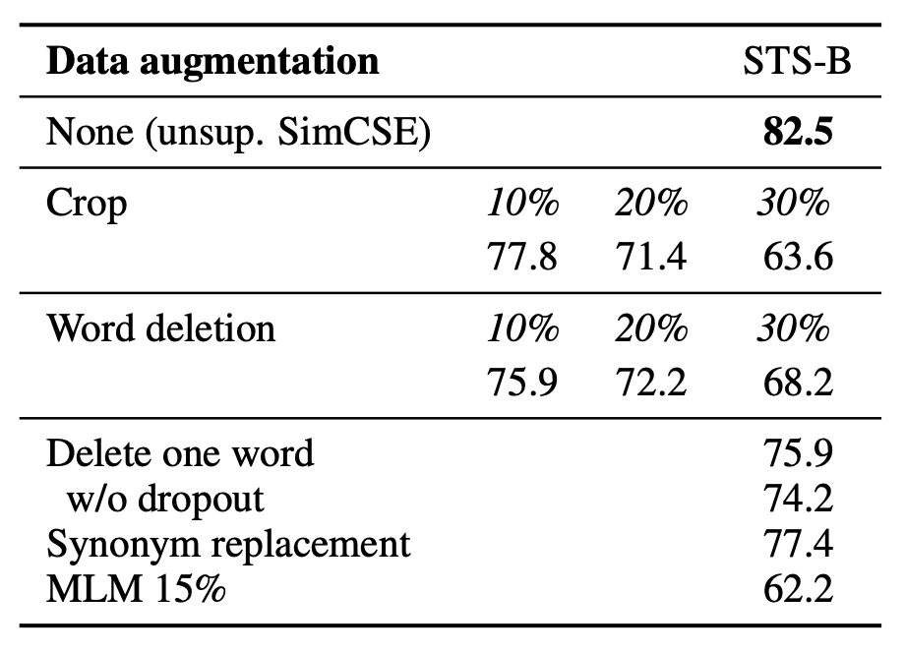
Why Dropout?
Better than crop, word deletion and replacement
Simple but super effective

Slide 92
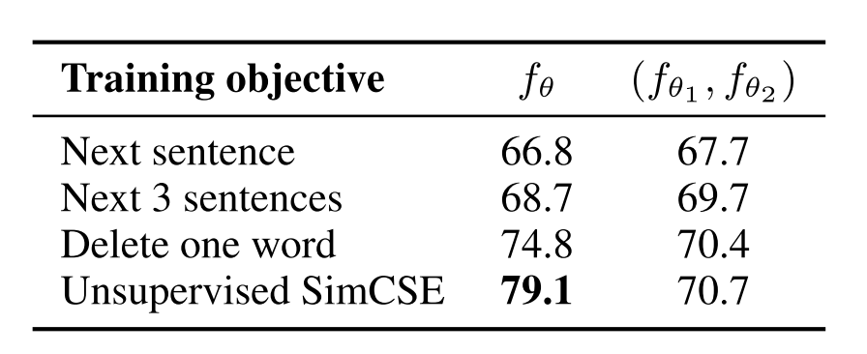
Why Self-Prediction?
STS-B results
share encoder dual encoder
QuickThoughts (pos: Next Sentence)
Self-Prediction (pos: Same Sentence)

Slide 93
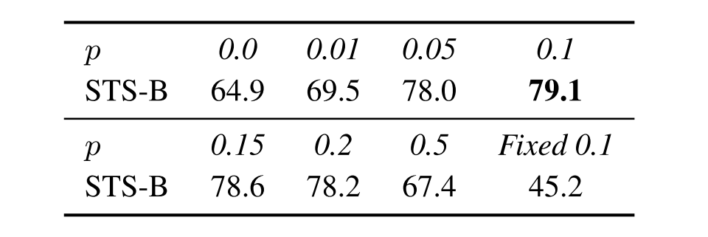
How to Dropout?
Fixed 0.1: apply the same dropout mask for two inputs -> leading to mode collapsing
Best: Two different dropout masks with p = 0.1

Slide 94
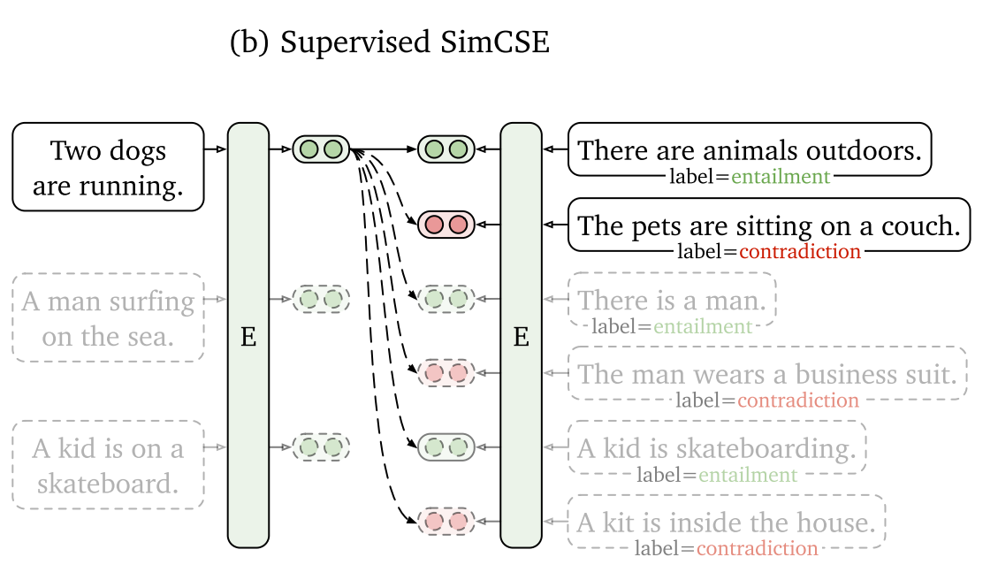
Supervised SimCSE

Slide 95
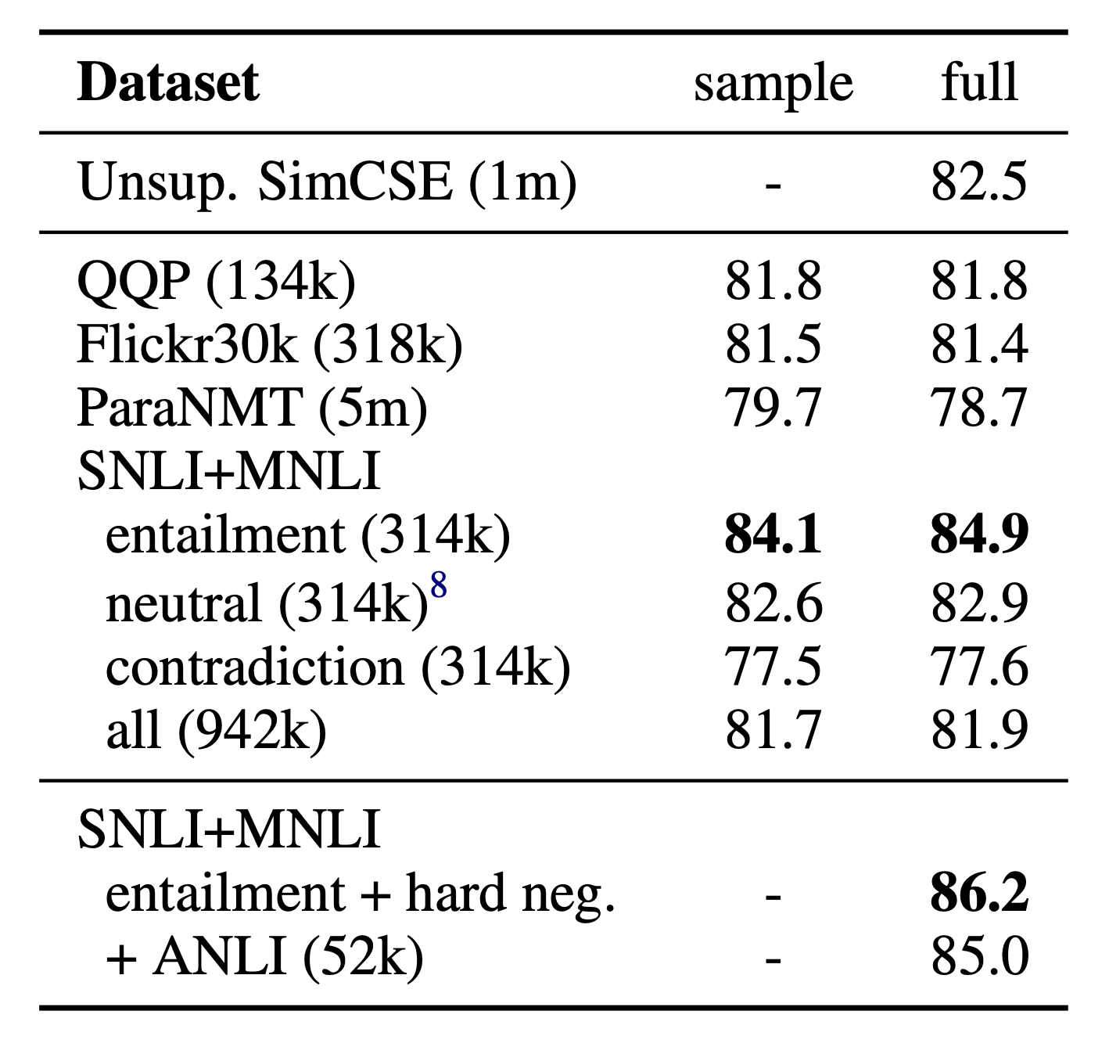
Supervised SimCSE
back-translation paraphrase
use contradict as negative examples

Slide 96
Supervised SimCSE
Unsupervised SImCSE v.s Supervised SimCSE
Supervised model is still performs much better -> Large space for unsupervised models to improve

Slide 97
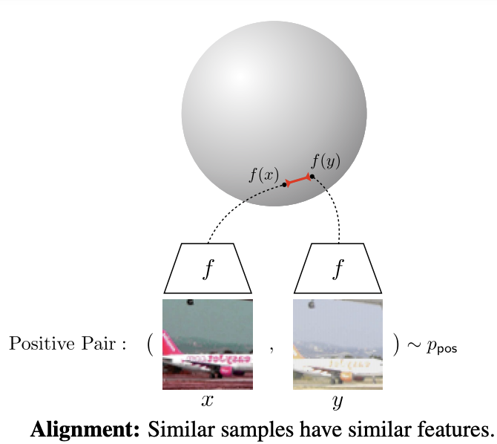
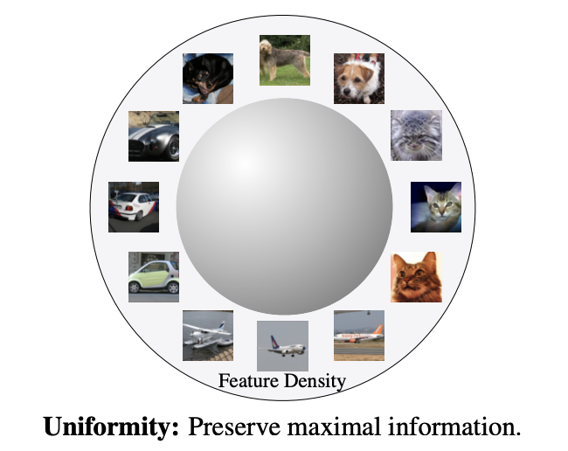
Alignment & Uniformity

Slide 98
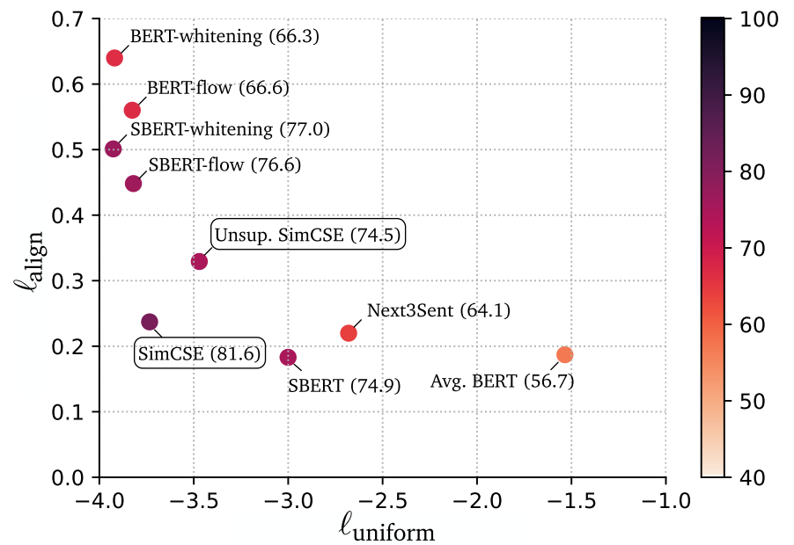
Analysis
Pre-trained embedding: good alignment poor uniformity => anisotropic

Slide 99
Analysis
Pre-trained embedding: good alignment poor uniformity => anisotropic
Post-processing methods (BERT-whitening/flow): good uniformity poor alignment

Slide 100
Analysis
Pre-trained embedding: good alignment poor uniformity => anisotropic
Post-processing methods (BERT-whitening/flow): good uniformity poor alignment
SimCSE: Best of the both worlds

Slide 101
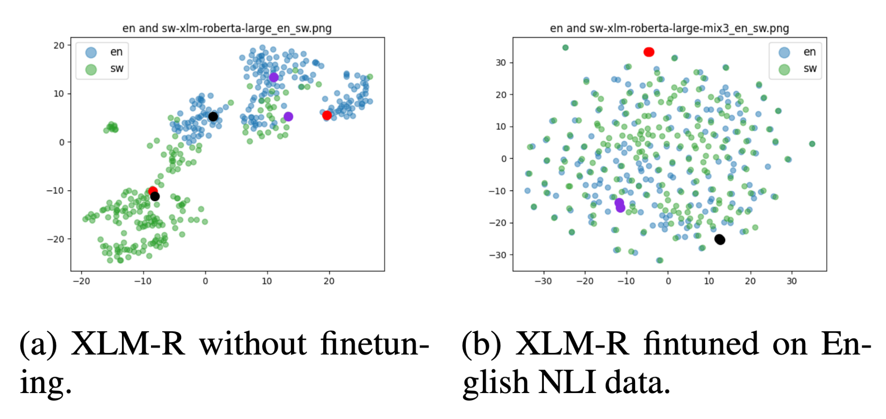
mSimCSE
Contrastive learning on only English data with multilingual models (mBERT, XLM-R) can align all other other languages without any parallel data.

Slide 102
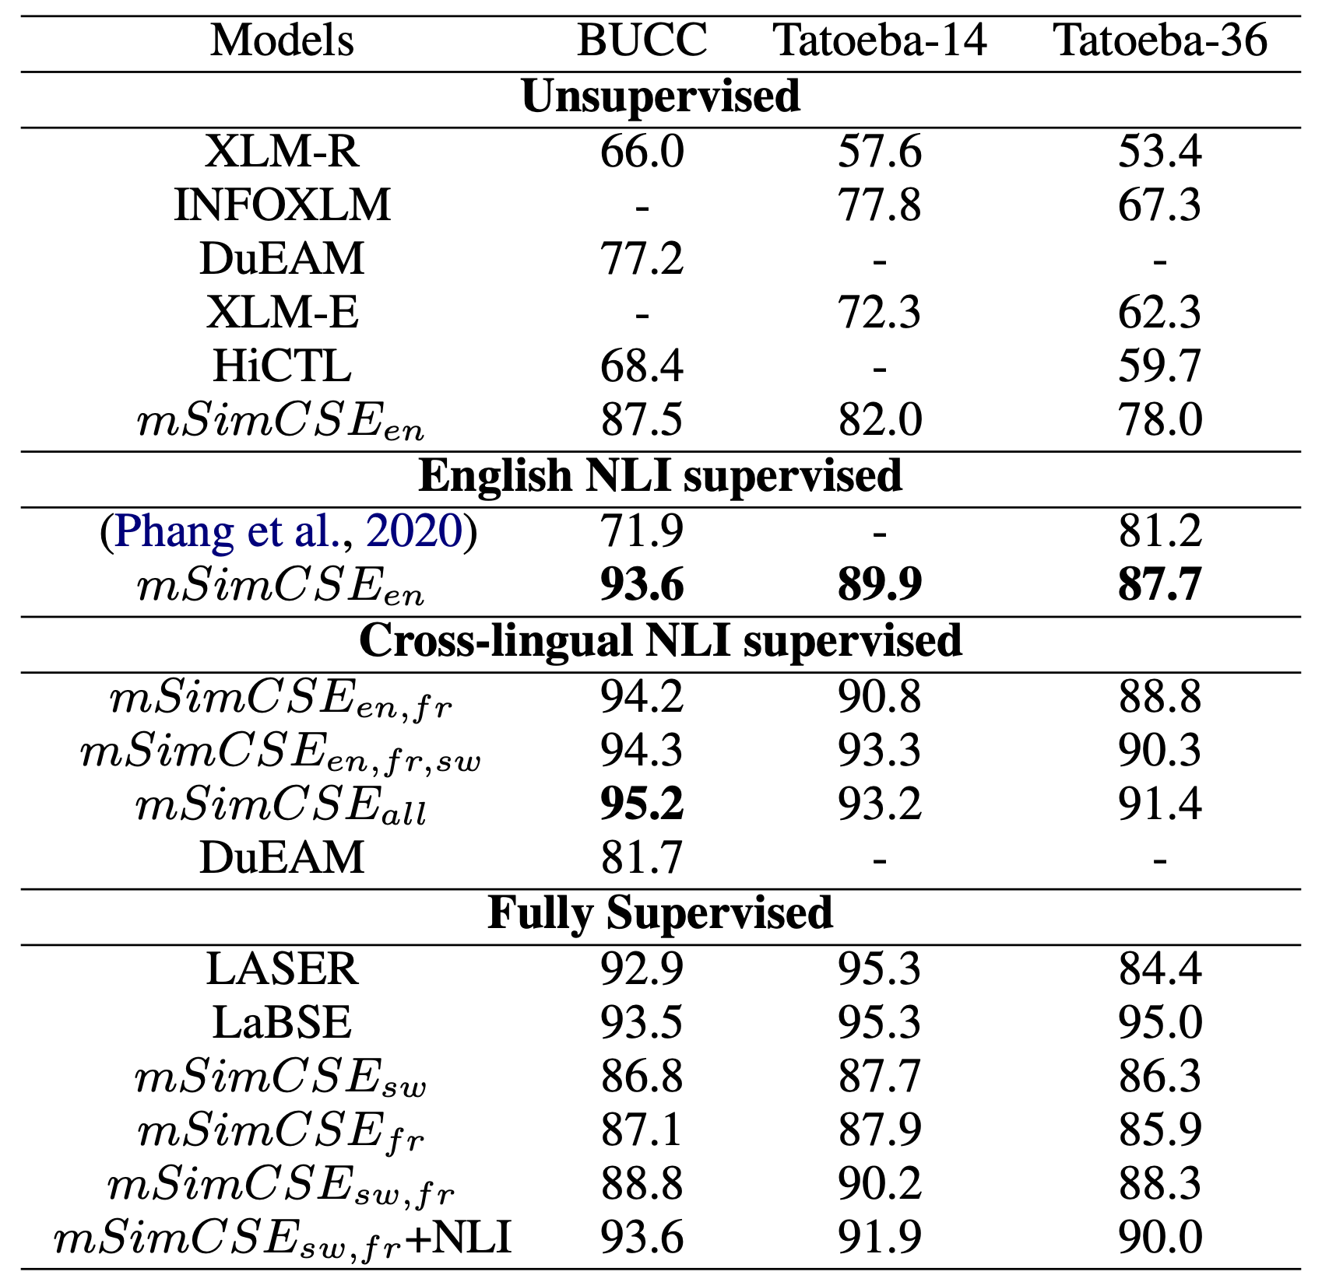
mSimCSE
mSimCSE performs close to supervised multilingual sentence encoder such as LaBSE.

Slide 103
Outline of Part 3
Why we need sentence-level representations?
Pre-BERT methods
How to obtain sentence-level representations from BERTs?
Post-processing Methods
Contrastive Learning Methods:
Designed Positives
Generating Positives
Bootstrapping Methods
Dropout Augmentations
Equivariant Contrastive Learning
Prompting
Ranking-based Methods
Conclusion

Slide 104
What we’ve learned from SimCSE?
Augmentations for natural language is hard:
Word deletion is not a good augmentation
Synonym replacement is not a good augmentation
Sentence cropping is not a good augmentation
Back-translation is not a good augmentation
…
They are all outperformed by simply changing dropout masks :(

Slide 105
Let's take a step back…
Q: Why do we need positive pairs in contrastive learning? A: to make the representations invariant to these kinds of augmentations.
Problem: It’s hard to produce semantically similar augmentations for natural language. Making the representations invariant to augmentations will hurt performance.
Q: Is there another way to utilize augmentations…? A: we can make the representations be aware of, but not necessarily invariant to the augmentations.

Slide 106
Background: Equivariant Contrastive Learning

Slide 107
Background: Equivariant Contrastive Learning

Slide 108
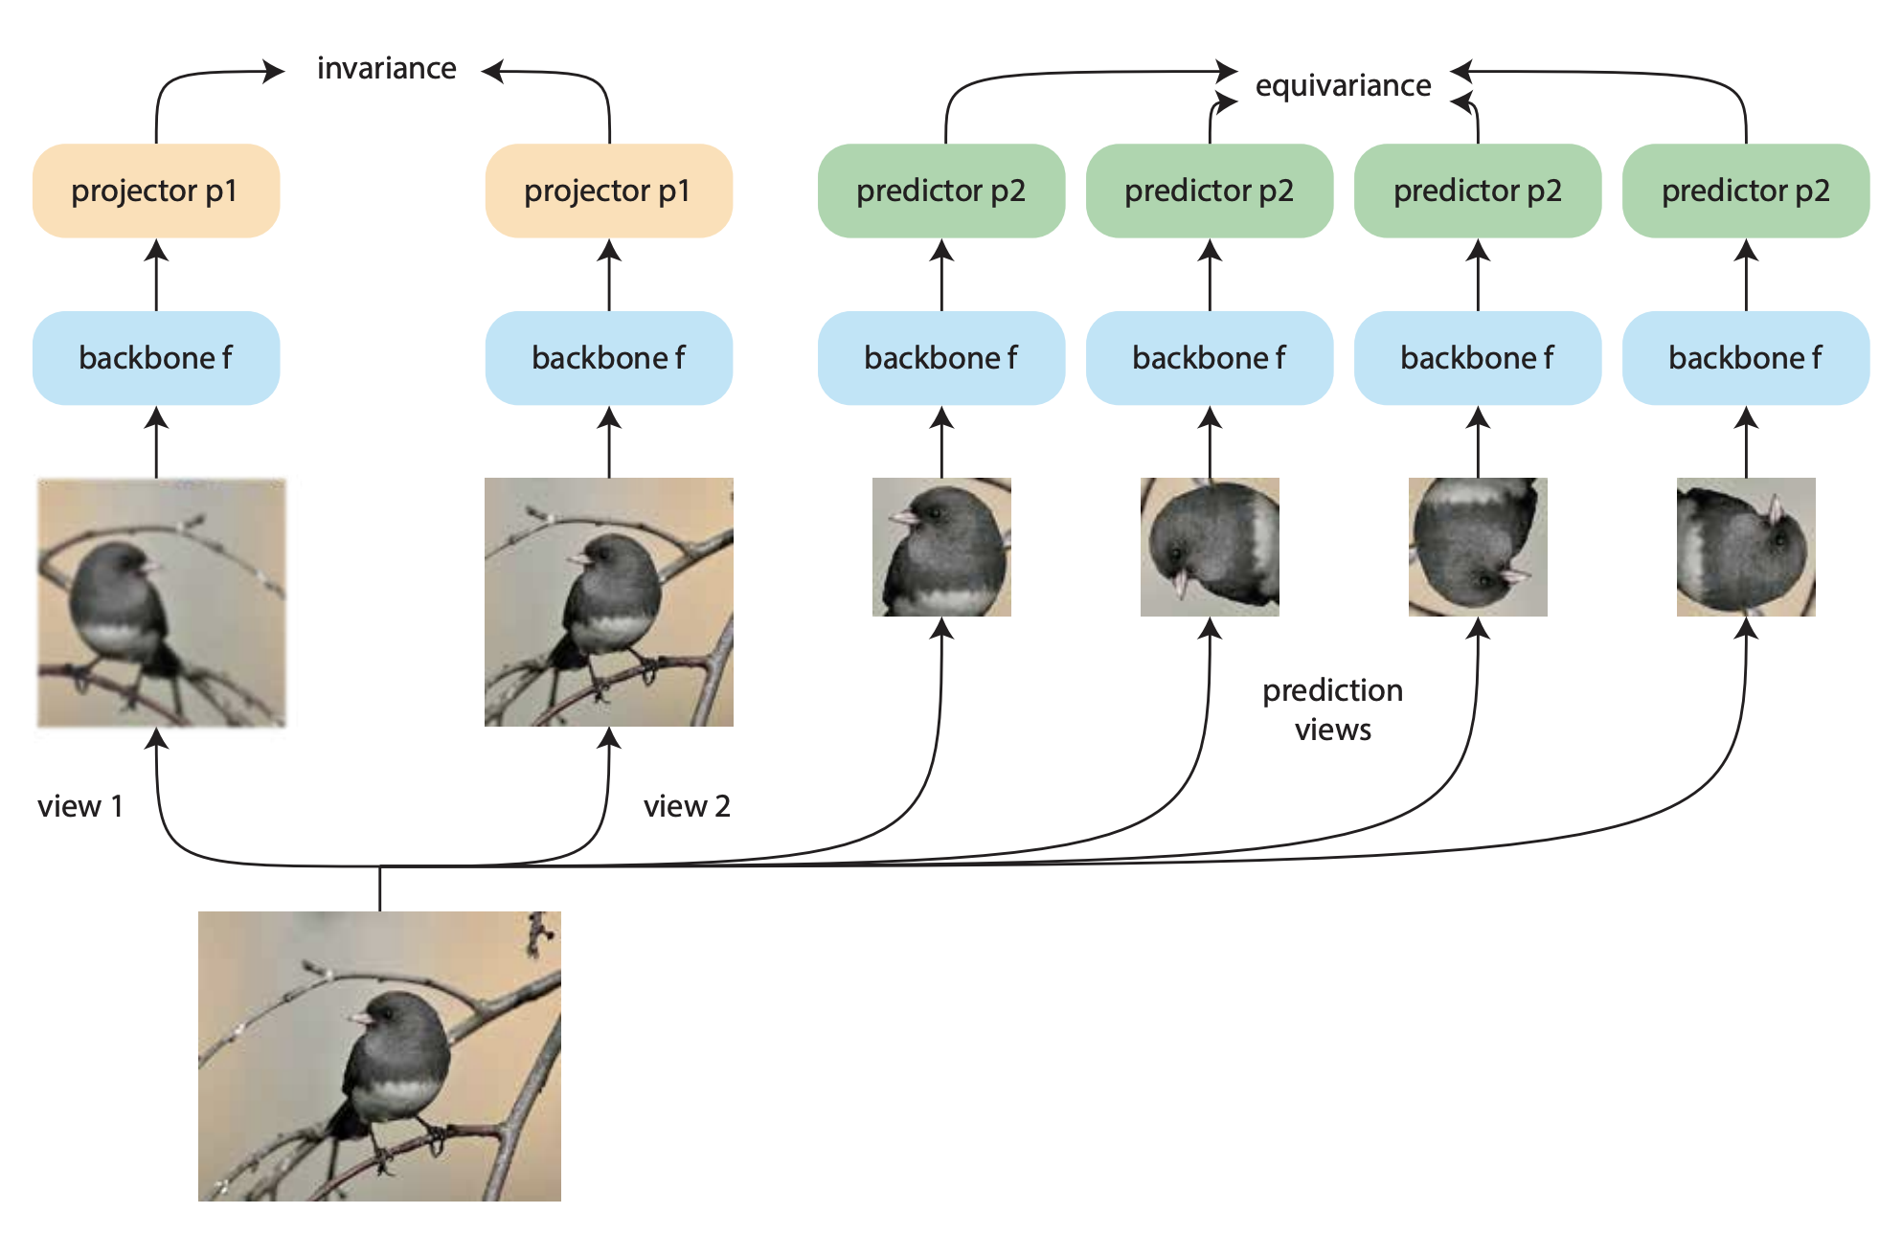
Background: Equivariant Contrastive Learning

Slide 109
Background: Equivariant Contrastive Learning
SimCLR (insensitive-based) can be a special case of Equivariant CL (insensitive+sensitive)

Slide 110
Background: Equivariant Contrastive Learning
SimCLR (insensitive-based) can be a special case of Equivariant CL (insensitive+sensitive)

Slide 111
DiffCSE
“sensitive”
“insensitive”

Slide 112
DiffCSE
“sensitive”
“insensitive”

Slide 113
DiffCSE
“sensitive”
“insensitive”
“insensitive”

Slide 114
DiffCSE
“sensitive”
“insensitive”
“insensitive”

Slide 115
DiffCSE
“sensitive”
“insensitive”
“insensitive”

Slide 116
DiffCSE
“sensitive”
ELECTRA?
“insensitive”
“insensitive”

Slide 117
DiffCSE
“sensitive”
ELECTRA?
“insensitive”
“insensitive”
conditional ELECTRA

Slide 118
DiffCSE
“sensitive”
ELECTRA?
“insensitive”
“insensitive”
conditional ELECTRA
“diff” operation

Slide 119
DiffCSE
“sensitive”
ELECTRA?
“insensitive”
“insensitive”
conditional ELECTRA
“diff” operation

Slide 120
DiffCSE
“sensitive”
“insensitive”
for inference

Slide 121
Results (STS)

Slide 122
Retrieval Results

Slide 123
Outline of Part 3
Why we need sentence-level representations?
Pre-BERT methods
How to obtain sentence-level representations from BERTs?
Post-processing Methods
Contrastive Learning Methods:
Designed Positives
Generating Positives
Bootstrapping Methods
Dropout Augmentations
Equivariant Contrastive Learning
Prompting
Ranking-based Methods
Conclusion

Slide 124
PromptBERT
Design/search good prompt templates to better extract sentence embeddings from BERT without fine-tuning
Further fine-tuning with contrastive loss:
Using sentence vectors produced by two different templates as a positive pair

Slide 125
PromptBERT
DiffCSE (BERT-base) 72.28 84.43 76.47 83.90 80.54 80.59 71.23 78.49

Slide 126
Outline of Part 3
Why we need sentence-level representations?
Pre-BERT methods
How to obtain sentence-level representations from BERTs?
Post-processing Methods
Contrastive Learning Methods:
Designed Positives
Generating Positives
Bootstrapping Methods
Dropout Augmentations
Equivariant Contrastive Learning
Prompting
Ranking-based Methods
Conclusion

Slide 127
RankEncoder
Refine the vector space of existing models like SimCSE, PromptBERT
Leverage ranking information from the whole corpus
Train a new encoder to match the cosine similarity of rank vectors

Slide 128
RankEncoder

Slide 129
RankEncoder
RankEncoder can be aware of the fine-grain interaction between the similar sentences in the corpus

Slide 130
RankEncoder
Better uniformity

Slide 131
Conclusion
We are closing the gap between unsupervised and supervised sentence representations:
Contrastive learning should have more potential in NLP for using pre-trained language models in representation learning!
RankEncoder (BERT-base) 74.88 85.59 78.61 83.50 80.56 81.55 75.78 80.07
PromptBERT (BERT-base) 75.48 85.59 80.57 85.99 81.08 84.56 80.52 81.97

Slide 132
Schedule
17:00 – 17:10 Part 1 Introduction [Hung-yi]
17:10 – 17:40 Part 2 Why do PLMs work [Hung-yi]
17:40 – 18:20 Part 3 How to use PLMs: Contrastive Learning for PLMs [Yung-Sung]
18:20 – 18:30 Q&A for Part 1+2+3
18:30 – 18:40 Break
18:40 – 19:05 Part 4 How to use PLMs: Parameter-efficient fine-tuning [Cheng-
19:00 – 19:30 Part 4 Han]
19:05 – 19:50 Part 5 How to use PLMs: Using PLMs with different amounts of data
19:30 – 20:15 Part 5 [Cheng-Han]
19:50 – 20:00 Conclusion and Future work + Q&A

Slide 133
2022 AACL-IJCNLP
Part 4:
How to use PLMs:
Parameter-efficient fine-tuning
Cheng-Han Chiang
National Taiwan University

Slide 134
Parameter-Efficient Fine-tuning
PLMs are gigantic
Need a copy for each downstream task
Fine-tuned Model
for Task 1
110M
Fine-tuned Model
for Task 2
110M
BERT
(a PLM)
Fine-tuned Model
for Task 3
110M
110M parameters
Fine-tuned Model
for Task 4
110M

Slide 135
Parameter-Efficient Fine-tuning
Problem: PLMs are gigantic (in terms of numbers of parameters, model size, and the storage needed to store the model)
Solution: Reduce the number of parameters by parameter-efficient fine-tuning

Slide 136
Parameter-Efficient Fine-tuning
Use a small amount of parameters for each downstream task
BERT
Task-specific para- meters for task 1
Fine-tune
BERT
Task-specific para- meters for task 2
BERT
BERT
Task-specific para- meters for task 3
110M parameters
BERT
Task-specific para- meters for task 4

Slide 137
Parameter-Efficient Fine-tuning
Use a small amount of parameters for each downstream task
Task-specific para- meters for task 1
Task-specific para- meters for task 2
BERT
BERT
Task-specific para- meters for task 3
110M parameters
Task-specific para- meters for task 4

Slide 138
Parameter-Efficient Fine-tuning
What is standard fine-tuning really doing?
Modify the hidden representations ($h$) of the PLM such that it can perform well on downstream task
$$h$$
Before Fine-tuning
[CLS]
Embedding Layer
Transformer Layer 1
Transformer Layer 2
Transformer Layer N
...
This movie is crap ...

Slide 139
Parameter-Efficient Fine-tuning
What is standard fine-tuning really doing?
Modify the hidden representations ($h$) of the PLM such that it can perform well on downstream task
$h$’
After Fine-tuning
[CLS]
Classifier Head
Embedding Layer
Transformer Layer 1
Transformer Layer 2
Transformer Layer N
...
This movie is crap ...

Slide 140
Parameter-Efficient Fine-tuning
Fine-tuning = modifying the hidden representation based on a PLM
Before Fine-tuning
After Fine-tuning
...
...
$$h$$
$$h^{′}$$
$$=h+Δh$$
$h$:hidden representation calculated by the original PLM
$$h^{′}=h+Δh$$
$h′$:hidden representation calculated by the fine-tuned model

Slide 141
2022 AACL-IJCNLP
Part 4:
How to use PLMs:
Parameter-efficient fine-tuning
4-1 Adapter

Slide 142
Parameter-Efficient Fine-tuning: Adapter
Use special submodules to modify hidden representations!
Before Fine-tuning
After Fine-tuning
...
Adapter
...
$$h$$
$$h^{′}$$
$$=h+Δh$$
$h$:hidden representation calculated by the original PLM
$$h^{′}=h+Δh$$
$h′$:hidden representation calculated by the fine-tuned model

Slide 143
Parameter-Efficient Fine-tuning: Adapter
Adapters: small trainable submodules inserted in transformers
Layer Norm
Layer Norm
+
+
Adapter
a Transformer Layer
Feed-forward
Feed-forward
Layer Norm
Layer Norm
+
+
Adapter
Multi-head
attention
Multi-head
attention

Slide 144
Parameter-Efficient Fine-tuning: Adapter
Adapters
$$h^{′}=h+Δh$$
Layer Norm
Adapter
$$h$$
+
+
$$Δh$$
Adapter
Feed-forward
up-project
Inside of the transformer layer, only adapters are updated
Feed-forward
Skip- connection
Layer Norm
Nonlinearity
+
Adapter
Feed-forward
down-project
hidden represen-tation
Multi-headed
attention
$$h$$

Slide 145
Parameter-Efficient Fine-tuning: Adapter
Adapters: During fine-tuning, only update the adpaters and the classifier head
Classifier Head
Adapter
+
Transformer Layer 12 w/ adapter
Feed-forward
up-project
...
Transformer Layer 2 w/ adapter
Nonlinearity
Transformer Layer 1 w/ adapter
Feed-forward
down-project
Embedding Layer

Slide 146
Parameter-Efficient Fine-tuning: Adapter
Adapters: All downstream tasks share the PLM; the adapters in each layer and the classifier heads are the task-specific modules
Classifier Head
Adapter
+
Transformer Layer 12 w/ adapter
Feed-forward
up-project
...
Transformer Layer 2 w/ adapter
Nonlinearity
Transformer Layer 1 w/ adapter
Feed-forward
down-project
Embedding Layer

Slide 147
Part 4:
How do PLMs work:
Parameter-efficient fine-tuning
4-2 LoRA

Slide 148
Parameter-Efficient Fine-tuning: LoRA
Use special submodules to modify hidden representations!
Before Fine-tuning
After Fine-tuning
LoRA
...
...
$$h$$
$$h^{′}=h+Δh$$

Slide 149
Parameter-Efficient Fine-tuning: LoRA
LoRA: Low-Rank Adaptation of Large Language Models
Layer Norm
Layer Norm
+
+
Feed-forward
LoRA
Feed-forward
Transformer layer
Layer Norm
Layer Norm
+
+
Multi-head
attention
Multi-head
attention

Slide 150
Parameter-Efficient Fine-tuning: LoRA
LoRA
+
Feed-forward
down-project
Feed-forward
down-project
Feed-forward
Nonlinearity
Nonlinearity
Feed-forward
up-project
+
Feed-forward
up-project

Slide 151
Parameter-Efficient Fine-tuning: LoRA
LoRA
$$h^{′}=h+Δh$$
+
$$Δh$$
$$h$$
$$d_{FFW}$$
$$d_{FFW}$$
$$r$$
Feed-forward
up-project
$$r$$
$$d_{model}$$
$$d_{model}$$

Slide 152
Parameter-Efficient Fine-tuning: LoRA
Low-Rank Adaptation of Large Language Models
Motivation: Downstream fine-tunings have low intrinsic dimension
Weight after fine-tuning $=W_{0}$ (pre-trained weight) $+ΔW$ (updates to the weight)
Hypothesis: The updates to the weight ($ΔW$) also gave a low intrinsic rank
Fine-tuned weight $=W_{0}+ΔW=W_{0}+BA$, rank $r≪\min{(d_{FFW},d_{model})}$
+
$$d_{FFW}$$
$$d_{FFW}$$
$$B$$
Pre-trained weight $$W_{0}$$
$$r$$
$$r$$
$$d_{model}$$
$$A$$
$$d_{model}$$
Notes:
What about the bias?

Slide 153
Parameter-Efficient Fine-tuning: LoRA
LoRA: All downstream tasks share the PLM; the LoRA in each layer and the classifier heads are the task-specific modules
Classifier Head
+
Transformer Layer 12 w/ LoRA
Feed-forward
down-project
...
Transformer Layer 2 w/ LoRA
Nonlinearity
Transformer Layer 1 w/ LoRA
+
Embedding Layer
Feed-forward
up-project

Slide 154
2022 AACL-IJCNLP
Part 4:
How do PLMs work:
Parameter-efficient fine-tuning
4-3 Prefix tuning

Slide 155
Parameter-Efficient Fine-tuning: Prefix Tuning
Use special submodules to modify hidden representations!
Before Fine-tuning
After Fine-tuning
...
Prefix
...
$$h$$
$$h^{′}=h+Δh$$

Slide 156
Parameter-Efficient Fine-tuning: Prefix Tuning
What is “prefix”
Something that is put in front of another something

Slide 157
Parameter-Efficient Fine-tuning: Prefix Tuning​
Prefix Tuning: Insert trainable prefix in each layer
Prefix
Prefix
Prefix
[BOS]
Embedding Layer
Transformer Layer 1
Transformer Layer 2
Transformer Layer N
...
This movie is crap ...

Slide 158
Prefix Tuning​
$${x′}_{1}$$
+
$${\hat{α}}_{1,1}$$
$$×$$
$${\hat{α}}_{1,2}$$
$$×$$
$${\hat{α}}_{1,3}$$
$$×$$
$${\hat{α}}_{1,4}$$
$$×$$
$${\hat{α}}_{1,5}$$
$$×$$
Softmax
Standard
Self-Attention
$$α_{1,1}$$
$$α_{1,2}$$
$$α_{1,3}$$
$$α_{1,4}$$
$$α_{1,5}$$
$$q_{1}$$
$$k_{1}$$
$$v_{1}$$
$$q_{2}$$
$$k_{2}$$
$$v_{2}$$
$$q_{3}$$
$$k_{3}$$
$$v_{3}$$
$$q_{4}$$
$$k_{4}$$
$$v_{4}$$
$$q_{5}$$
$$k_{5}$$
$$v_{5}$$
$$x_{1}$$
$$x_{2}$$
$$x_{3}$$
$$x_{4}$$
$$x_{5}$$

Slide 159
$${x′}_{1}$$
Prefix Tuning​
$$h^{′}=h+Δh$$
$$Δh$$
$$h$$
+
$${\hat{α}}_{1,p_{1}}$$
$$×$$
$${\hat{α}}_{1,p_{2}}$$
$$×$$
$${\hat{α}}_{1,p_{3}}$$
$$×$$
$${\hat{α}}_{1,1}$$
$$×$$
$${\hat{α}}_{1,2}$$
$$×$$
$${\hat{α}}_{1,3}$$
$$×$$
$${\hat{α}}_{1,4}$$
$$×$$
$${\hat{α}}_{1,5}$$
$$×$$
Softmax
$$α_{1,p_{1}}$$
$$α_{1,p_{2}}$$
$$α_{1,p_{3}}$$
$$α_{1,1}$$
$$α_{1,2}$$
$$α_{1,3}$$
$$α_{1,4}$$
$$α_{1,5}$$
$$k_{p_{1}}$$
$$v_{p_{1}}$$
$$k_{p_{2}}$$
$$v_{p_{2}}$$
$$k_{p_{3}}$$
$$v_{p_{3}}$$
$$q_{1}$$
$$k_{1}$$
$$v_{1}$$
$$q_{2}$$
$$k_{2}$$
$$v_{2}$$
$$q_{3}$$
$$k_{3}$$
$$v_{3}$$
$$q_{4}$$
$$k_{4}$$
$$v_{4}$$
$$q_{5}$$
$$k_{5}$$
$$v_{5}$$
Prefix
$$p_{1}$$
$$p_{2}$$
$$p_{3}$$
$$x_{1}$$
$$x_{2}$$
$$x_{3}$$
$$x_{4}$$
$$x_{5}$$
Notes:
Originally this is for autoregressive LM (GPT2) or encoder-decoder (BART)

Slide 160
Parameter-Efficient Fine-tuning: Prefix Tuning​
Prefix Tuning: Only the prefix (key and value) are updated during fine-tuning
$$k_{p_{1}}$$
$$v_{p_{1}}$$
$$k_{p_{2}}$$
$$v_{p_{2}}$$
$$k_{p_{3}}$$
$$v_{p_{3}}$$
Prefix in layer 12
Transformer Layer 12
...
...
$$k_{p_{1}}$$
$$v_{p_{1}}$$
$$k_{p_{2}}$$
$$v_{p_{2}}$$
$$k_{p_{3}}$$
$$v_{p_{3}}$$
Prefix in layer 2
Transformer Layer 2
$$k_{p_{1}}$$
$$v_{p_{1}}$$
$$k_{p_{2}}$$
$$v_{p_{2}}$$
$$k_{p_{3}}$$
$$v_{p_{3}}$$
Transformer Layer 1
Prefix in layer 1
Embedding Layer
Notes:
Cross attention of self attention?

Slide 161
2022 AACL-IJCNLP
Part 4:
How do PLMs work:
Parameter-efficient fine-tuning
4-4 (Soft) Prompt tuning

Slide 162
Parameter-Efficient Fine-tuning: Soft Prompting
Soft Prompting
Prepend the prefix embedding at the input layer
Prefix embedding
Transformer Layer 1
Transformer Layer 2
[BOS]
Transformer Layer N
Input sequence
Embedding Layer
...

Slide 163
Parameter-Efficient Fine-tuning: Soft Prompting
Soft Prompting can be considered as the soften version of prompting
(Hard) prompting: add words in the input sentence
translate
the
sentence
Embedding Layer
Transformer Layer 1
Transformer Layer 2
[BOS]
Transformer Layer N
Hard prompt
...

Slide 164
Parameter-Efficient Fine-tuning: Soft Prompting
Hard Prompts: words (that are originally in the vocabulary)
Are there any restrictions on these vectors
Length of the soft prompts?
Soft Prompts: vectors (can be initialized from some word embeddings)o select prompts?
Prompt length?
Translate
the
sentence
譯
譯

Slide 165
Parameter-Efficient Fine-tuning: Soft Prompting
How to determine the length of the soft prompt embedding
The prompt needs to be long enough
Increasing the prompt length shows diminishing performance gain when the length is long enough

Slide 166
Parameter-Efficient Fine-tuning: Soft Prompting
How to initialize the soft prompt embedding?
Random initialization
Sample from the word embedding of top 5000 frequent words
Class label in the downstream task

Slide 167
2022 AACL-IJCNLP
Part 4:
How do PLMs work:
Parameter-efficient fine-tuning
4-5 Short summary

Slide 168
Parameter-Efficient Fine-tuning
Fine-tuning = modifying the hidden representation based on a PLM
Before Fine-tuning
After Fine-tuning
...
...
$$h$$
$$h^{′}$$
$$=h+Δh$$
$h$:hidden representation calculated by the original PLM
$$h^{′}=h+Δh$$
$h′$:hidden representation calculated by the fine-tuned model

Slide 169
Parameter-Efficient Fine-tuning: Adapter
Adapters
$$h^{′}=h+Δh$$
Layer Norm
Adapter
$$h$$
+
+
$$Δh$$
Adapter
Feed-forward
up-project
Inside of the transformer layer, only adapters are updated
Feed-forward
Layer Norm
Nonlinearity
+
Adapter
Feed-forward
down-project
hidden represen-tation
Multi-headed
attention
$$h$$

Slide 170
Parameter-Efficient Fine-tuning: LoRA
LoRA
$$h^{′}=h+Δh$$
+
$$Δh$$
$$h$$
$$d_{FFW}$$
$$d_{FFW}$$
$$r$$
Feed-forward
up-project
$$r$$
$$d_{model}$$
$$d_{model}$$

Slide 171
$${x′}_{1}$$
Prefix Tuning​
$$h^{′}=h+Δh$$
$$Δh$$
$$h$$
+
$${\hat{α}}_{1,p_{1}}$$
$$×$$
$${\hat{α}}_{1,p_{2}}$$
$$×$$
$${\hat{α}}_{1,p_{3}}$$
$$×$$
$${\hat{α}}_{1,1}$$
$$×$$
$${\hat{α}}_{1,2}$$
$$×$$
$${\hat{α}}_{1,3}$$
$$×$$
$${\hat{α}}_{1,4}$$
$$×$$
$${\hat{α}}_{1,5}$$
$$×$$
Softmax
$$α_{1,p_{1}}$$
$$α_{1,p_{2}}$$
$$α_{1,p_{3}}$$
$$α_{1,1}$$
$$α_{1,2}$$
$$α_{1,3}$$
$$α_{1,4}$$
$$α_{1,5}$$
$$k_{p_{1}}$$
$$v_{p_{1}}$$
$$k_{p_{2}}$$
$$v_{p_{2}}$$
$$k_{p_{3}}$$
$$v_{p_{3}}$$
$$q_{1}$$
$$k_{1}$$
$$v_{1}$$
$$q_{2}$$
$$k_{2}$$
$$v_{2}$$
$$q_{3}$$
$$k_{3}$$
$$v_{3}$$
$$q_{4}$$
$$k_{4}$$
$$v_{4}$$
$$q_{5}$$
$$k_{5}$$
$$v_{5}$$
Prefix
$$p_{1}$$
$$p_{2}$$
$$p_{3}$$
$$x_{1}$$
$$x_{2}$$
$$x_{3}$$
$$x_{4}$$
$$x_{5}$$
Notes:
Originally this is for autoregressive LM (GPT2) or encoder-decoder (BART)

Slide 172
Parameter-Efficient Fine-tuning: Soft Prompting
Soft Prompting
Prepend the prefix embedding at the input layer
Prefix embedding
Transformer Layer 1
Transformer Layer 2
[BOS]
Transformer Layer N
Embedding Layer
...

Slide 173
Parameter-Efficient Fine-tuning
Benefit 1: Drastically decreases the task-specific parameters
 | Adapter | LoRA | Prefix Tuning | Soft Prompt
Task-specific parameters* | $${Θ(d}_{model}rL)$$ | $${Θ(d}_{model}rL)$$ | $$Θ(d_{model}nL)$$ | $Θ(d_{model}n)$
Percent Trainable | <5% | <0.1% | <0.1% | <0.05%
Trainable parameters Illustration
+
+
$n$:Prefix length
$n$:Prefix length
$$r$$
$$r$$
$$k_{p_{1}}$$
$$v_{p_{1}}$$
$$k_{p_{n}}$$
$$v_{p_{n}}$$
...
...
Nonlinearity
$$r$$
$$r$$
*not including the classifier head

Slide 174
Parameter-Efficient Fine-tuning
Benefit 2: Less easier to overfit on training data; better out-of-domain performance
Standard
Soft Prompt
=Soft Prompt - Standard
Training dataset
OOD test dataset

Slide 175
Parameter-Efficient Fine-tuning
Benefit 3: Fewer parameters to fine-tune, making them good candidates when training with small dataset
Dataset (Train set size)
RoBERTa-full model
RoBERTa-adapter, r=256

Slide 176
Parameter-Efficient Fine-tuning
Which parameter-efficient fine-tuning should one select?
No one-size-fit-all
Full-model
83.23
Parameter- efficient fine-tuning
90.55
83.02
Boldface: best performance
Underline: second best performance

Slide 177
Schedule
17:00 – 17:10 Part 1 Introduction [Hung-yi]
17:10 – 17:40 Part 2 Why do PLMs work [Hung-yi]
17:40 – 18:20 Part 3 How to use PLMs: Contrastive Learning for PLMs [Yung-Sung]
18:20 – 18:30 Q&A for Part 1+2+3
18:30 – 18:40 Break
18:40 – 19:05 Part 4 How to use PLMs: Parameter-efficient fine-tuning [Cheng-
19:00 – 19:30 Part 4 Han]
19:05 – 19:50 Part 5 How to use PLMs: Using PLMs with different amounts of data
19:30 – 20:15 Part 5 [Cheng-Han]
19:50 – 20:00 Conclusion and Future work + Q&A

Slide 178
2022 AACL-IJCNLP
Part 5:
How do PLMs work:
Using PLMs with different amounts of data
Cheng-Han Chiang
National Taiwan University

Slide 179
Using PLMs with different amounts of data
Our goal: fine-tune a model for a target downstream task using a PLM
Traditionally, we assume that we have sufficient amount of data for the target task
Target task dataset (labeled)

Slide 180
Using PLMs with different amounts of data
Our goal: fine-tune a model for a target downstream task using a PLM
Sometimes, we have additional labeled dataset for other datasets
Target task dataset (labeled)
Datasets of other tasks (labeled)

Slide 181
Using PLMs with different amounts of data
Our goal: fine-tune a model for a target downstream task using a PLM
Sometimes, labeled data for the target task is scarce
Target task dataset (labeled)

Slide 182
Using PLMs with different amounts of data
Our goal: fine-tune a model for a target downstream task using a PLM
Sometimes, we only have a few labeled data for the target task, and we have unlabeled dataset related to the target task
Target task dataset (labeled)
Target task dataset (Unlabeled)

Slide 183
Using PLMs with different amounts of data
Our goal: fine-tune a model for a target downstream task using a PLM
Sometimes, we have no labeled data for the target task
Target task dataset (labeled)

Slide 184
Using PLMs with different amounts of data
Our goal: fine-tune a model for a target downstream task using a PLM
How to use PLMs with different amount of data?
Target task dataset (labeled)
Datasets of other tasks (labeled)
Data related to target task (Unlabeled)

Slide 185
2022 AACL-IJCNLP
Part 5:
How do PLMs work:
Using PLMs with different amounts of data
5-1: Intermediate-task fine-tuning: using labeled data from other tasks

Slide 186
Intermediate-task fine-tuning
Goal: Obtain a model for task (target task)
Standard supervised learning
Target task dataset
Pre-trained language model
Fine-tuned model for target task

Slide 187
Intermediate-task fine-tuning
Goal: Obtain a model for task (target task)
Intermediate-task fine-tuning: transfer the knowledge from a model fine-tuned on other tasks (intermediate-tasks)
Intermediate-task dataset(s)
Target task dataset
Pre-trained language model
Fine-tuned model for intermediate-tasks
Fine-tuned model for target task

Slide 188
Intermediate-task fine-tuning
What kind of intermediate tasks can help target task?
This paper studies the transferability of 33 datasets, which can be categorized into three types: classification (CR), question answering (QA), and sequence labeling (SL)

Slide 189
Intermediate-task fine-tuning
What kind of intermediate tasks can help target task?
$p_{t}$: the performance of directly fine-tuning on target task $t$
$p_{s→t}$: the performance of transferring from intermediate-task $s$ to a target task $t$
Target task (CR)
Intermediate-task (CR)
$$p_{s→t}$$
$$p_{s→t}$$
$$p_{t}$$

Slide 190
Intermediate-task fine-tuning
What kind of intermediate tasks can help target task?
$p_{t}$: the performance of directly fine-tuning on target task $t$
$p_{s→t}$: the performance of transferring from intermediate-task $s$ to a target task $t$
Target task (CR)
Intermediate-task (CR)

Slide 191
Intermediate-task fine-tuning
What kind of intermediate tasks can help target task?
The relative transfer gain is defined as $g_{s→t}=\frac{p_{s→t}−p_{t}}{p_{t}}$
Same type of tasks is the most beneficial

Slide 192
Intermediate-task fine-tuning
Does the dataset size affect the transferability of intermediate tasks?
Limited dataset size: 1K training samples only
Intermediate-task transfer is beneficial even when the intermediate-task or the target task has limited data
Intermediate (src)$→$ target

Slide 193
Intermediate-task fine-tuning
When fine-tuning the whole model, we will have a full-sized model for each intermediate task
Fine-tuned Model
for Intermediate-Task A
13B
Fine-tuned Model
for Intermediate-Task B
13B
Fine-tuned Model
for Intermediate-Task C
13B
Fine-tuned Model
for Intermediate-Task D
13B
Full model (T5-13B) fine-tuning

Slide 194
Intermediate-task fine-tuning
When fine-tuning with soft prompt tuning, we only need to transfer the prompt embedding instead of the whole model
Fine-tuned Model
for Intermediate-Task A
Prompt for Intermediate-Task A
13B
204K
Fine-tuned Model
for Intermediate-Task B
Prompt for Intermediate-Task B
13B
204K
0.00184%
Fine-tuned Model
for Intermediate-Task C
Prompt for Intermediate-Task C
13B
204K
Fine-tuned Model
for Intermediate-Task D
Prompt for Intermediate-Task D
13B
204K
Full model (T5-13B) fine-tuning
Prefix tuning

Slide 195
Intermediate-task fine-tuning
Soft Prompt Transfer (SPoT): Using soft prompts for transferring
SPoT yields positive transfer in many cases
MNLI is a good intermediate-task
Intermediate-task
relative transfer gain
Target task

Slide 196
Intermediate-task fine-tuning
Soft Prompt Transfer (SPoT): The soft prompt of a task can be used as the task embedding of that task.
Prompt embedding
Task
embedding
Prompt for Task A
Prompt for Task B
Prompt for Task C
Prompt for Task D
Prompt embedding library

Slide 197
Intermediate-task fine-tuning
Soft Prompt Transfer (SPoT): Given a novel task, we can first train only using the novel task, and find a intermediate task whose task embedding is most similar to the novel task and use it to transfer
Cosine similarity = 0.87
Prompt for Target Task
(without initializing the prompt using soft prompt transfer)
Prompt for Task A
Prompt for Task B
Prompt for Task C
Prompt for Task D
Cosine similarity = 0.42
Prompt embedding library

Slide 198
Intermediate-task fine-tuning
Soft Prompt Transfer (SPoT): Selecting the best intermediate-task soft prompt
(16 target tasks)
w/o SPoT:
Oracle SPoT:

Slide 199
2022 AACL-IJCNLP
Part 5:
How do PLMs work:
Using PLMs with different amounts of data
5-1.1: Multi-task fine-tuning: 5-1.1: using labeled data from other tasks

Slide 200
Multi-task fine-tuning
Fine-tune the PLM using the auxiliary task datasets and the target task dataset simultaneously
Fine-tuned model for all tasks
Auxiliary task dataset(s)
Target task dataset
How to weight the loss of different tasks?

Slide 201
2022 AACL-IJCNLP
Part 5:
How do PLMs work:
Using PLMs with different amounts of data
5-2: Prompt tuning for few-shot learning

Slide 202
Prompt tuning for few-shot learning
Standard fine-tuning mostly assumes a large amount of labeled data
Pre-trained Language Model
(Fine-tuning)
(size of training set)

Slide 203
[CLS] Jack likes dog. [SEP] Jack loves ice cream. [SEP] >>> 1
[CLS] The spring break is coming soon. [SEP] The spring break was over. [SEP] >>> 2
[CLS] I am going to have dinner. [SEP] I am going to eat something. [SEP] >>> 0
……
[CLS] Mary likes pie. [SEP] Mary hates pie. [SEP] >>> ?
0: entailment 1: neutral
2: contradiction
2
NLI model
Natural language inference (NLI): premise + hypothesis

Slide 204
Prompt tuning for few-shot learning
Data scarcity in downstream tasks is very common
Few-shot learning: We have some labeled training data
”Some” $≈$ less than a hundred
Pre-trained Language Model
Target task dataset (labeled)

Slide 205
[CLS] The spring break is coming soon. [SEP] The spring break was over. [SEP] >>> 2
[CLS] I am going to have dinner. [SEP] I am going to eat something. [SEP] >>> 0
[CLS] Mary likes pie. [SEP] Mary hates pie. [SEP] >>> ?
?????
Natural language inference (NLI): premise + hypothesis

Slide 206
Prompt tuning for few-shot learning
[CLS] The spring break is coming soon. Is it true that the spring break was over? >>> no
[CLS] I am going to have dinner. Is it true that I am going to eat something? >>> yes
[CLS] Mary likes pie. Is it true that Mary hates pie. [SEP] >>> ?
no
Natural language inference (NLI): premise + hypothesis

Slide 207
Prompt tuning for few-shot learning
By converting the data points in the dataset into natural language prompts, the model may be easier to know what it should do
[CLS] The spring break is coming soon. [SEP] The spring break was over. [SEP] >>> contradiction
[CLS] I am going to have dinner. [SEP] I am going to eat something. [SEP] >>> entailment
[CLS] Mary likes pie. [SEP] Mary hates pie. [SEP] >>> ?
[CLS] The spring break is coming soon. Is it true that the spring break was over? >>> no
[CLS] I am going to have dinner. Is it true that I am going to eat something? >>> yes
[CLS] Mary likes pie. Is it true that Mary hates pie. [SEP] >>> ?

Slide 208
Prompt tuning for few-shot learning
Format the downstream task as a language modelling task with pre-defined templates into natural language prompts

Slide 209
Prompt tuning for few-shot learning
What you need in prompt tuning
A prompt template
A PLM
A verbalizer
...
good
yes
run
joy
no
maybe
Premise | Mary likes pie.
Hypothesis | Mary hates pie.
Label | 2
BERT
LM Head
yes
maybe
Prompt template:
no
Premise
? [MASK],
Hypothesis

Slide 210
Prompt tuning for few-shot learning
What you need in prompt tuning
1. A prompt template: convert data points into a natural language prompt
Premise | Mary likes pie
Hypothesis | Mary hates pie
Label | 2
Mary likes pie
? [MASK],
Mary hates pie
Prompt template
Premise
? [MASK],
Hypothesis

Slide 211
Prompt tuning for few-shot learning
What you need in prompt tuning
2. A PLM: perform language modeling
...
good
yes
run
joy
no
maybe
BERT
LM Head
Prompt template:
Premise
? [MASK],
Hypothesis

Slide 212
Prompt tuning for few-shot learning
What you need in prompt tuning
3. A verbalizer: A mapping between the label and the vocabulary
Which vocabulary should represents the class “entailment”
0
1
2
Softmax
yes
maybe
no
...
good
yes
run
joy
no
maybe
Notes:
Unnormalized score or normalized one?

Slide 213
Prompt tuning for few-shot learning
Prompt tuning
The whole PLM will be fine-tuned
...
good
yes
run
joy
no
maybe
Premise | Mary likes pie.
Hypothesis | Mary hates pie.
Label | 2
BERT
LM Head
Prompt template:
Premise
? [MASK],
Hypothesis

Slide 214
Prompt tuning for few-shot learning
Prompt tuning
Standard fine-tuning
Classifier Head
LM Head
LM Head
BERT
(a PLM)
BERT
(a PLM)
Premise
? [MASK],
Hypothesis
Premise
[SEP]
Hypothesis
* I omit the [CLS] at the beginning and the [SEP] at the end

Slide 215
Prompt tuning for few-shot learning
Prompt tuning has better performance under data scarcity because
It incorporates human knowledge
It introduces no new parameters
Prompt Tuning
Standard Fine-tuning

Slide 216
Prompt tuning for few-shot learning
How to select the verbalizer?
1. Manual design: require task-specific knowledge
yes
maybe
no

Slide 217
Prompt tuning for few-shot learning
How to select the verbalizer?
2. Search from the vocabulary
Step 1: For each sample of the same class $c$ in the training dataset, convert them into prompts
...
good
yes
no
joy
false
otherwise
Premise | Mary likes pie.
Hypothesis | Mary hates pie.
Label | 2
LM Head
BERT
(a PLM)
All the contradiction training
samples
...
Premise | I saw her yesterday.
Hypothesis | I didn’t met her.
Label | 2
Premise
? [MASK],
Hypothesis

Slide 218
Prompt tuning for few-shot learning
How to select the verbalizer?
2. Search from the vocabulary
Step 2: Sum the LM head prediction for all the samples of class $c$ and find the $top$-$k$ words for class $c$
Top 2 predictions
...
otherwise/no
good
yes
no
joy
false
otherwise

Slide 219
Prompt tuning for few-shot learning
How to select the verbalizer?
2. Search from the vocabulary
Step 3: Repeat for all classes and find their $top$-$k$ words
fine/meaning
...
plus/maybe
otherwise/no
good
yes
no
joy
false
otherwise

Slide 220
Prompt tuning for few-shot learning
How to select the verbalizer?
2. Search from the vocabulary
Step 4: Fine-tune using different verbalizers to obtain different models, and then evaluate those models on the evaluation set to select the best one
fine/meaning
plus/maybe
otherwise/no

Slide 221
Prompt tuning for few-shot learning
How to select the verbalizer?
2. Prototypical verbalizer: use learnable prototype vectors to represent a class, instead of using the words in the vocabulary
Instance representation
Learnable prototype vector
News title

Slide 222
Prompt tuning for few-shot learning
How to select the verbalizer?
2. Prototypical verbalizer
Instance representation
[CLS]
A
[MASK]
Embedding Layer
Linear layer
Transformer Layer 1
Transformer Layer 2
Transformer Layer N
...
news
:
...

Slide 223
Prompt tuning for few-shot learning
How to select the verbalizer?
2. Prototypical verbalizer
Trained by contrastive learning: (1) instance-instance contrastive
Positive samples
Negative samples

Slide 224
Prompt tuning for few-shot learning
How to select the verbalizer?
2. Prototypical verbalizer
Trained by contrastive learning: (2) instance-prototype contrastive
Positive sample
Negative samples

Slide 225
Prompt tuning for few-shot learning
How to select the verbalizer?
2. Prototypical verbalizer
Inference by finding the prototype that is most similar with the testing data’s instance representation
Cosine sim.
Testing sample

Slide 226
Prompt tuning for few-shot learning
How to select the verbalizer?
$K$: Number of training data for each class
Manual verbalizer is good most of the time, but it requires task-specific knowledge

Slide 227
Prompt tuning for few-shot learning
How to select the verbalizer?
$K$: Number of training data for each class
Prototypical verbalizer requires no task-specific knowledge and can work well even when there is only one label for each class

Slide 228
Prompt tuning for few-shot learning
Can we further improve the few-shot performance of PLMs?
LM-BFF: better few-shot fine-tuning of language models
Core concept: prompt + demonstration

Slide 229
Prompt tuning for few-shot learning
LM-BFF
Demonstrations can improve the performance of prompt tuning and makes the variance smaller
$K$= 16
Standard fine-tuning
Prompt tuning + demonstration (LM-BFF)
Notes:
Variance due to training sample or prompt template

Slide 230
Prompt tuning for few-shot learning
Question: What’s the difference between prompting and probing
Answer:
The concept of “prompting” is first used in recent NLP community for probing the factual knowledge of a PLM
Prompts

Slide 231
Prompt tuning for few-shot learning
Question: What’s the difference between prompting and probing
Answer:
Probing is the process of exploring what knowledge is encoded in the PLM. PLMs are often fixed during probing.
Prompting means using natural language to query the PLM, perhaps for the downstream task. PLM can be fine-tuned during prompting.
The purpose of prompting and probing are different.

Slide 232
2022 AACL-IJCNLP
Part 5:
How do PLMs work:
Using PLMs with different amounts of data
5-3: Semi-supervised learning with PLMs

Slide 233
Semi-supervised learning with PLMs
Semi-Supervised learning: We have some labeled training data and a large amount of unlabeled data
Core idea: use the labeled data to train a good model and use that model to label the unlabeled data
Pre-trained Language Model
Fine-tuned model
predict
Unlabeled data of target task
Unlabeled data with pseudo-label
Labeled data of target task

Slide 234
Semi-supervised learning with PLMs: PET
Pattern-Exploiting Training (PET)
Step 1: Use different prompts and verbalizer to prompt-tune different PLMs on the labeled dataset
Prompt Tune
BERT
Hypothesis
BERT
LM Head
Premise
? [MASK],
LM Head
yes
maybe
no
...
...
“
Prompt Tune
Premise
“
? [MASK].
“
Hypothesis
“
BERT
LM Head
BERT
LM Head
true
inconclusive
false

Slide 235
Semi-supervised learning with PLMs: PET
Pattern-Exploiting Training (PET)
Step 2: Predict the unlabeled dataset and combine the predictions from different models
BERT
Premise
? [MASK],
Hypothesis
LM Head
Predict
yes
maybe
0
1
2
no
...
...
BERT
“
LM Head
Premise
“
? [MASK].
“
Hypothesis
“
0
1
2
Predict
true
Soft label
inconclusive
0
1
2
false

Slide 236
Semi-supervised learning with PLMs: PET
Pattern-Exploiting Training (PET)
Step 3: Use a PLM with classifier head to train on the soft-labeled data set
Classifier Head
BERT
(a PLM)
0
1
2
(Originally) Unlabeled data
Soft label
Premise
[SEP]
Hypothesis

Slide 237
Semi-supervised learning with PLMs: PET
Pattern-Exploiting Training (PET)
Experiment results
$|𝒯|$: # of labeled
samples

Slide 238
Semi-supervised learning with PLMs: STraTa
Self-Training with Task Augmentation (STraTA)
Self-training: use the model’s prediction on the unlabeled dataset as pseudo-label
How to initialize the models is critical to the performance
Notes:
確定一下這個的縮寫怎麼唸

Slide 239
Semi-supervised learning with PLMs: STraTa
Self-Training with Task Augmentation (STraTA)
Task augmentation: use unlabeled data to generate an NLI dataset, and fine-tuned on the NLI dataset as the intermediate task to obtain the base model
Intermediate- task model
Synthetic NLI Dataset

Slide 240
Semi-supervised learning with PLMs: STraTa
Self-Training with Task Augmentation (STraTA)
Task augmentation: sentiment classification as the target task
Step 1: Train an NLI data generator using another labeled NLI dataset using a generative language model
Hypothesis
Generative language model (T5)
Additional labeled NLI dataset
entailment
Premise

Slide 241
Semi-supervised learning with PLMs: STraTa
Self-Training with Task Augmentation (STraTA)
Task augmentation: sentiment classification as the target task
Step 2: Use the trained data generator to generate NLI dataset using the in-domain unlabeled data
Hypothesis
NLI data generator model
Labels of NLI
Unlabeled sentiment classification dataset
entailment
Sample
contradiction
entailment
neutral

Slide 242
Semi-supervised learning with PLMs: STraTa
Self-Training with Task Augmentation (STraTA)
Task augmentation: sentiment classification as the target task
Step 2: Use the trained data generator to generate NLI dataset using the in-domain unlabeled data
Hypothesis
NLI data generator model
Labels of NLI
Unlabeled sentiment classification dataset
entailment
Sample
contradiction
entailment
neutral

Slide 243
Semi-supervised learning with PLMs: STraTa
Self-Training with Task Augmentation (STraTA)
Task augmentation: sentiment classification as the target task
Step 3: Use the generated in-domain NLI dataset to fine-tune an NLI model. The fine-tuned model is used to initialize the teacher model and student model in self-training
The unlabeled data
contradiction
Hypothesis
Fine-tune
Pre-trained Language Model
entailment
Hypothesis
neutral
Hypothesis

Slide 244
Semi-supervised learning with PLMs: STraTa
Self-Training with Task Augmentation (STraTA)
Task augmentation: using sentiment classification as an example
Step 3: Use the generated in-domain NLI dataset to fine-tune an NLI model. The fine-tuned model is used to initialize the teacher model and student model in self-training
Intermediate -Task Model
Synthetic NLI Dataset

Slide 245
Semi-supervised learning with PLMs: STraTa
Self-Training with Task Augmentation (STraTA)

Slide 246
2022 AACL-IJCNLP
Part 5:
How do PLMs work:
Using PLMs with different amounts of data
5-4: Zero-shot learning

Slide 247
Zero-shot learning
Zero-shot inference: inference on the downstream task without any training data
If you don’t have training data, then we need a model that can zero-shot inference on downstream tasks
Pre-trained Language Model
Training data

Slide 248
Zero-shot learning
GPT-3 shows that zero-shot (with task description) is possible

Slide 249
Zero-shot learning
Question: Where does this zero-shot ability spring from?
Hypothesis: during pre-training, the training datasets implicitly contains a mixture of different tasks
QA
Summarization

Slide 250
Zero-shot learning
Hypothesis: multi-task training enables zero-shot generalization
Why not train a model with multi-task learning on a bunch of dataset?
Multi-task
intermediate-task fine-tuning
Zero-shot Generalization

Slide 251
Zero-shot learning
Intermediate-task fine-tuning with some types of tasks
Zero-shot inference on other types of tasks
Zero-shot tasks
Intermediate-tasks

Slide 252
Zero-shot learning
Sometimes achieves performance better than GPT-3 (175B parameters) with only 11B parameters
Different points represents different prompts
Variance due to prompts can be large

Slide 253
Zero-shot learning
What language model architecture and pre-training objective work best for zero-shot generalization?
it is a funny movie <sos>
funny movie <sos>
a funny
FLM
PLM
MLM
<bos> it is a funny movie
<bos> it is a
it is [MASK] movie

Slide 254
Zero-shot learning
What language model architecture and pre-training objective work best for zero-shot generalization?
a NC decoder <sos>
PLM
<bos> i am
Prefix

Slide 255
Zero-shot learning
What language model architecture and pre-training objective work best for zero-shot generalization?
MTF: Multi-Task Fine-tuning

Slide 256
Zero-shot learning
What language model architecture and pre-training objective work best for zero-shot generalization?
Encoder-decoder model pre-trained using MLM is the best
MTF: Multi-Task Fine-tuning

Slide 257
2022 AACL-IJCNLP
Part 5:
How do PLMs work:
Using PLMs with different amounts of data
5-5: Short summary

Slide 258
Using PLMs with different amount of data
PLMs can be used with different amount of labeled and unlabeled data
Special designs need to be made under different scenarios
Target task dataset (labeled)
Datasets of other tasks (labeled)
Data related to target task (Unlabeled)

Slide 259
Using PLMs with different amount of data
Use natural language prompts and add scenario-specific designs
[CLS] The spring break is coming soon. Is it true that the spring break was over? >>> no
[CLS] I am going to have dinner. Is it true that I am going to eat something? >>> yes
[CLS] Mary likes pie. Is it true that Mary hates pie. [SEP] >>> ?
yes

Slide 260
Schedule
17:00 – 17:10 Part 1 Introduction [Hung-yi]
17:10 – 17:40 Part 2 Why do PLMs work [Hung-yi]
17:40 – 18:20 Part 3 How to use PLMs: Contrastive Learning for PLMs [Yung-Sung]
18:20 – 18:30 Q&A for Part 1+2+3
18:30 – 18:40 Break
18:40 – 19:05 Part 4 How to use PLMs: Parameter-efficient fine-tuning [Cheng-
19:00 – 19:30 Part 4 Han]
19:05 – 19:50 Part 5 How to use PLMs: Using PLMs with different amounts of data
19:30 – 20:15 Part 5 [Cheng-Han]
19:50 – 20:00 Conclusion and Future work + Q&A

Slide 261
2022 AACL-IJCNLP
Conclusion and Future Work + Q&A

Slide 262
Conclusion
Researchers have studied why PLMs are useful from many aspects
Contrastive learning is a powerful method to obtain high quality sentence embedding in an unsupervised way
Parameter-efficient fine-tuning can achieve comparable performance to full-model fine-tuning
PLMs can be used in with different amount of labeled and unlabeled datasets, and incorporating human knowledge is very critical the performance

Slide 263
Future work
Why PLMs work is not completely answered yet, including the mathematical theory / learning theory behind the PLMs
How can we create better negative and positive samples for contrastive learning in an unsupervised way?
How can we combine parameter-efficient fine-tuning methods with other methods (pruning, compression, quantization) to further reduce the parameters?
How does those few-shot learning methods perform domain-specific datasets?
How trust-worthy are the prediction of PLMs, especially in few-shot and zero-shot?

Slide 264
Future work
Why is the variance between different prompts very large for certain tasks? Does this imply the PLM fail to understand human language?
How do we continuously adapt PLMs to different domain and datasets from different time?
Still a long way to go!

Slide 265
Recent Advances in PLMs: Why Do They Work and How to Use Them
Any questions?
2022 AACL-IJCNLP
Part 1 Introduction
Part 2 Why do PLMs work
Part 3 How to Use PLMs: Contrastive learning
Part 4 Parameter-efficient finetuning
Part 5 Using PLMs with different amounts of data

